Slide 1
Au-delà du lambda
Benjamin Guinebertière
Technical Evangelist, Microsoft France
@benjguin
Vincent Heuschling
Fondateur et Architecte, Affini-Tech
@vhe74

Slide 2
Introduction

Slide 3
Agenda
Architecture lambda
Remise en cause de l'architecture lambda
Challenges du streaming
Introduction boontadata
Démo boontadata
Contribuez !
Démo contribution (dev test labs)

Slide 4
L’architecture lambda et sa remise en cause

Slide 5
Big Data / ML - Architecture typique
Big Data Engines
Machine Learning
API
API
IOT
NoSQL Databases
Social
Web
Data Lake
Web
Mobile
Relational Databases
logs
…
Enter-prise
…
BI / DataViz
Sens dans lequel va la donnée (vs sens des appels RPC)
Notes:
Data lake stores all the data that can be used in nearly raw format (it may be compressed for instance).
It is in nearly raw format so that everything can be stored, there is no need to throw any data.
Data can be easily used in low latency scenarios (interactive mobile / web use cases) when it is stored in databases.
There are two main database families:
relational databases.
They have the following advantages:
They allow any kind of queries.
Data is consistent because it’s stored once
They all use SQL as a language (different dialects may exist)
They have the following drawbacks:
Scaling is thru scale up (more powerfull machine)
Data schema must be designed with specific rules (cf https://en.wikipedia.org/wiki/Database_normalization)
NoSQL databases:
They have the following advantages:
Data can be stored in a format which corresponds to the way development objects exist in code
Scaling is thru scale out (more machines)
They have the following drawbacks:
Consistency between different copies of the same piece of data need to be managed by the application (ex: a customer name can be in orders, sales, logistics, …)
Each no SQL engine has its own API. NB: most NoSQL engine tend to also have SQL as a query language with restrictions like no joins between tables (so that scale out can happen)
Data Lake is implemented as a distributed file system: HDFS by default in Hadoop, Kudu by Cloudera, MapR-FS by MapR, Azure blob storage, Azure Data Lake Store.
In order to query and transform data stored in the data lake you need a distributed engine (Big Data Engine). You focus on the code (SQL in Hive, Pig latin in Pig, Java, Scala, Python, …) and the framework distributed it on worker nodes that may or may not be collocated with the data. Typical big data engines include Hadoop, Spark, Azure Data Lake Analytics.
Having raw data kept in Data Lake allows the following scenario: you are missing a field in your database. You can add this field in the database schema AND you can fill its value from past data that you kept in the data lake even before you knew you would need that field.
Databases may also be a major source for DataViz (data visualization) and Business Intelligence (BI).
BI may use OLAP / multidimensional engines (like SQL Server Analysis Services) or in memory column storage (like PowerPivot, SQL Datawarehouse / SQL DB Column store index, Spark SQL cache based on Parquet, Hive+TEZ+ORC, …)
The most interesting use cases are often implemented with Machine learning. This is a way to program thru examples. For instance, you show the machine pictures with cats, and picture without cats. After a while the machine knows if a picture contains a cat or not. Another easiest one is to predict the value of column N based on the value of the N-1 other columns. The main phases of machine learning are:
Learn from the labelled (you know the Nth column value, or if a picture has a cat) dataset
Predict the past where you have labelled data and evaluate the performance of the model. Ex: you can predict at 85% whether a picture has a cat.
Predict in production for unlabeled data.
You may need to have all those phases backed by API so that you can update the model based on new learning data; you also need to predict thru API.
The prediction API may be hybrid between human prediction and machine learning prediction. One can use a workflow that tried to predict thru machine learning; if not possible, then the machine can escalate to a human, and add the labelled data to its learning dataset. A few times later, escalation may become useless. This is a way to have machine learning from humans.
A global API will add business rules on top of databases data and machine learning API. This API will be called by Web, Mobile apps or other channels (phone servers, …). The API may be internal or public so that external developers can develop their own app based on the public API.
Data Lake gets its data from multiple sources: IOT sensors, social networks, web, logs, enterprise data, … One additional source is the application itself which will generate additional data. In order to have all data available in the data lake, it may be interesting to copy also that data in the data lake.

Slide 6

Ingestion
données poussées vers un broker: approche de type streaming / « hot path »
Donnée poussée vers un stockage: approche compatible avec la plupart des systèmes existants, souvent de type batch / « cold path »

Slide 7

Traitement
Plusieurs instances de traitement peuvent travailler sur le même « broker ». Cas d’usages: indexation pour tableau de bord, transformation, curation, file d’attente avant stockage, …
Plusieurs instances de traitement peuvent travailler sur le stockage non structuré. Cas d’usages: requêtes ad-hoc sur donnée non préparée, Transformation, …

Slide 8

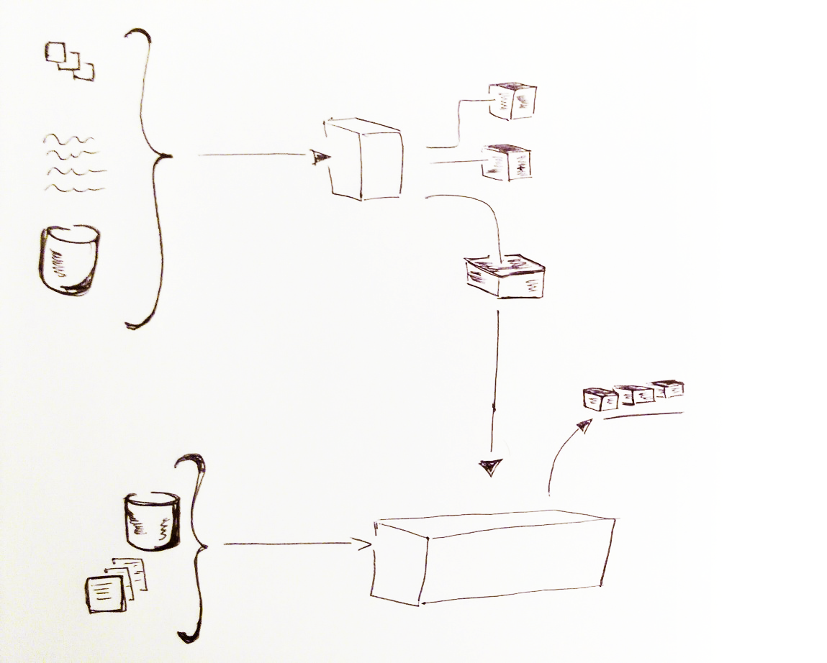
Préparation
Le broker peut être vu comme un “log” que plusieurs solutions peuvent traiter. Cas d’usages: ETL, traitement en continu pour réduction de la latence d’observation
Un des types de traitement peut être de pousser la donnée vers le stockage
En mettant la donnée dans du stockage non structuré, on peut disposer de toute la donnée (pas de schéma), afin d’alimenter les bases SQL et noSQL dont le schéma peut évoluer en ajoutant des champs qui recevront aussi la donnée passée.

Slide 9




Mise à disposition
La mise à disposition via des bases SQL ou noSQL est optimisée ici pour la latence d’observation, mais peut avoir d’autres contraintes.
La mise à disposition via des bases SQL, noSQL ou sur les données brutes permet un plus grand nombre de scénarios, au prix d’une latence un peu plus importante.

Slide 10
Architecture Lambda
Events
hot path
Near
Real Time
DB
SQL/noSQL
query
&
merge
cold path
storage
batch
Storage, DB SQL/noSQL
Notes:
T

Slide 11
Big Data vs Business Intelligence
Schéma à la lecture => je peux tout écrire
Schéma à l’écriture => je peux lire rapidement

Slide 12
Composants fondamentaux du Big Data
broker
data lake
moteurs de traitement
bases de données
dataViz

Slide 13
broker
IEventProcessor
Event Processor Host
Azure Event Hub
Direct
Receivers
> 1M Producers
> 1GB/sec
Aggregate
Throughput
Consumer Group(s)
Partitions
Event Producers
PartitionKey
Hash
AMQP 1.0
Credit-based flow control
Client-side cursors
Offset by Id or Timestamp
Throughput Units:
1 ≤ TUs ≤ Partition Count
TU: 1 MB/s writes, 2 MB/s reads
Up to 32 partitions via portal, more on request

Slide 14
data lake
HDFS
MapR FS
Amazon s3
Google File System
Azure Blob Storage
Azure Data Lake Store
Co localité des données
cluster à cluster

Slide 15

moteurs de traitement

Slide 16
Bases de données
SQL
  moteur relationnel permettant
  tout type de requêtes
  langage de requêtes
    SQL
    noSQL (CQL, …)
    Hive, Presto, Drill, SparkSQL, …
NoSQL
  Scale out
  colonnes
  documents
  clefs/valeurs
  graphes
  réparties
  rapides en écriture
  rapides en lecture

Slide 17
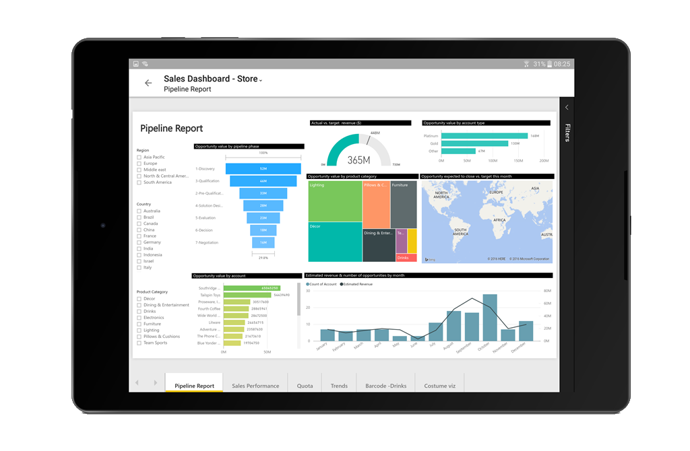
dataviz

Slide 18
aka.ms/hellodata

Slide 19
Remise en cause
http://bigdatahebdo.azurewebsites.net/episodes/2016/05/16/EP23_Kafka_a_Devoxxfr/
https://engineering.linkedin.com/blog/2016/06/stream-processing-hard-problems-part-1-killing-lambda
http://imply.io/post/2016/07/05/exactly-once-streaming-ingestion.html
https://www.mapr.com/ebooks/intro-to-apache-flink/chapter-6-batch-is-a-special-case-of-streaming.html
…

Slide 20
Architecture non lambda
hot path
Near
Real Time
DB
SQL/noSQL
query
events log
cold path
Events
batch
Notes:
T

Slide 21
le streaming et ses challenges

Slide 22
Exemple
Evénements:
Heure | Objet A | Objet B
10:00:00 | 100 | 2000
10:00:03 |  | 1800
10:00:04 | 85
10:00:07 | 40 | 2500
10:00:08 | 100
10:00:09 |  | 3000
Aggrégations:
Fenêtre de temps | Objet A (somme) | Objet B (moyenne)
10:00:05 | 185 | 1900
10:00:10 | 140 | 2750

Slide 23
un système distribué
broker
objet A
broker
Moteur de
traitement
broker
objet B

Slide 24
cas idéal
B,m2,2000
B,m3,1800
B,m6,2500
B,m8,3000
A,m1,100
A,m7,100
A,m4,85
A,m5,40
10:00:00
10:00:01
10:00:02
10:00:03
10:00:04
10:00:05
10:00:06
10:00:07
10:00:08
10:00:09
10:00:10
10:00:11
10:00:12

Slide 25
événements dupliqués
B,m3,1800
A,m5,40
B,m2,2000
B,m6,2500
B,m2,2000
B,m8,3000
A,m1,100
B,m8,3000
B,m8,3000
A,m1,100
A,m7,100
A,m4,85
A,m5,40
10:00:00
10:00:01
10:00:02
10:00:03
10:00:04
10:00:05
10:00:06
10:00:07
10:00:08
10:00:09
10:00:10
10:00:11
10:00:12

Slide 26
événements dans le désordre
B,m2,2000
B,m3,1800
B,m6,2500
B,m8,3000
A,m1,100
A,m7,100
A,m4,85
A,m5,40
10:00:00
10:00:01
10:00:02
10:00:03
10:00:04
10:00:05
10:00:06
10:00:07
10:00:08
10:00:09
10:00:10
10:00:11
10:00:12

Slide 27
événements en retard
B,m2,2000
B,m3,1800
B,m6,2500
B,m8,3000
A,m7,100
A,m4,85
A,m5,40
A,m1,100
10:00:00
10:00:01
10:00:02
10:00:03
10:00:04
10:00:05
10:00:06
10:00:07
10:00:08
10:00:09
10:00:10
10:00:11
10:00:12

Slide 28
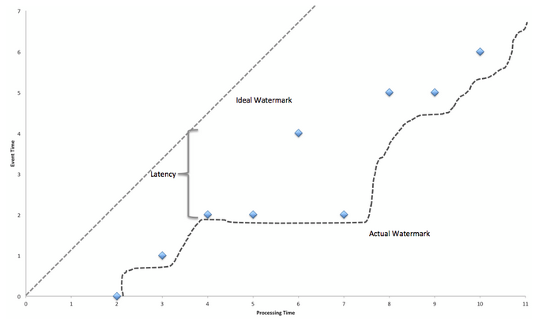
Apache Flink
Notes:
from https://cwiki.apache.org/confluence/display/FLINK/Time+and+Order+in+Streams

Slide 29
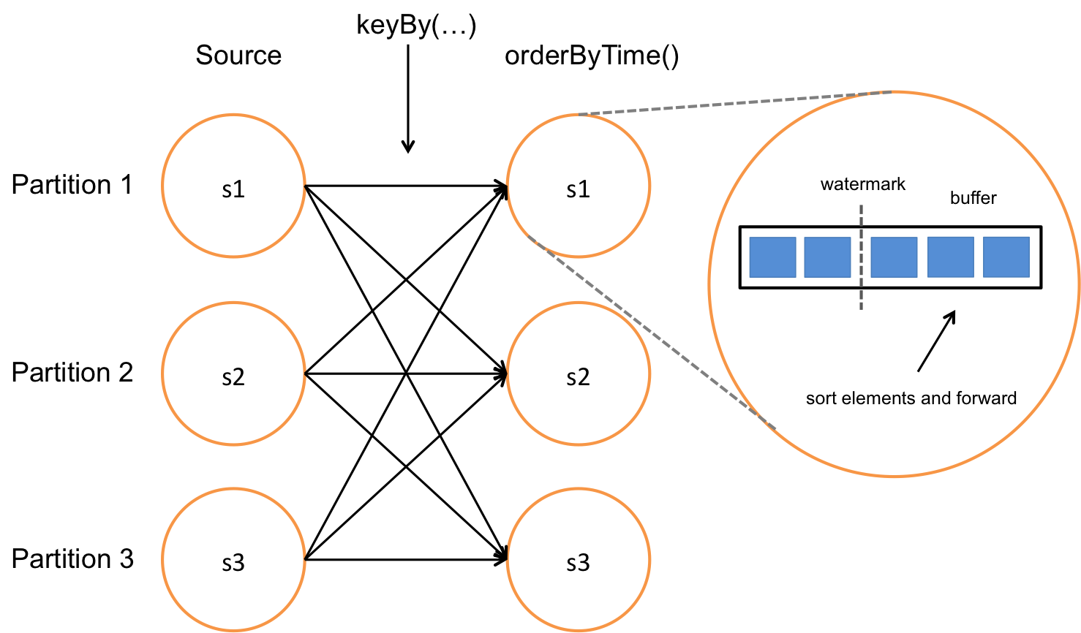
Apache Flink
Notes:
from https://cwiki.apache.org/confluence/display/FLINK/Time+and+Order+in+Streams

Slide 30
boontadata

Slide 31

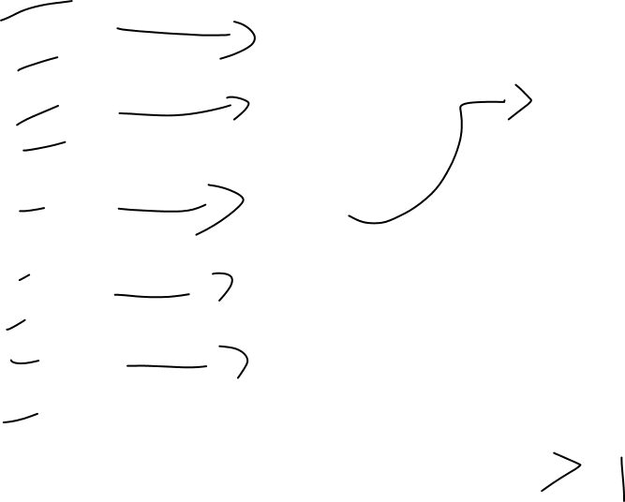
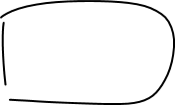


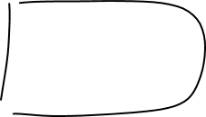
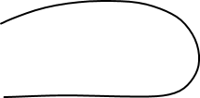



Storm
Flink
Samza
Spark
Streaming
…

Slide 32
boontadata
Streaming engine #1
Kafka broker
Streaming engine #2
IOT simulator
Streaming engine #...
Cassandra noSQL Database
compare

Slide 33
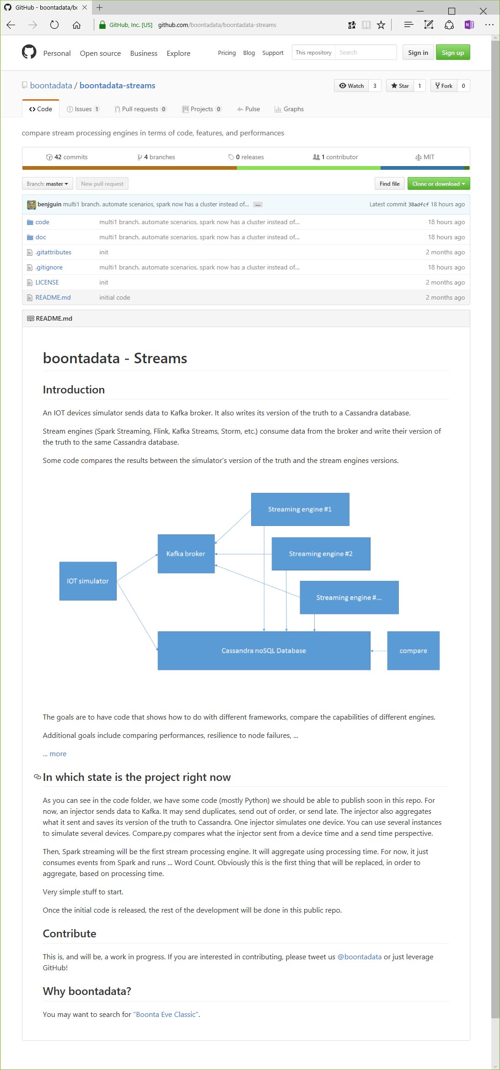
http://boontadata.io

Slide 34
boontadata

Slide 35
Contribuez !
boontadata-streams
  Ajout de Frameworks
    Kafka Streams, Beam, Apex, Storm, …
  Amélioration du code
    indexes dans Cassandra
    Flink lit Kafka 0.10 nativement
    …
boontadata-vstsbuild
  automatisation avec Visual Studio Team Services
boontadata-azurepaas
  les mêmes scénarios en Azure PaaS

Slide 36
Environnement pour la contribution à boontadata-streams

Slide 37
Conclusion

Slide 38
Contribuez !
http://boontadata.io

Slide 39

Benjamin Guinebertière
Technical Evangelist, Microsoft France
Azure, data insights, machine learning
@benjguin | http://3-4.fr

