Slide 1

Robot - Azure - IoT
Aymeric Weinbach
DEVCON #3

Slide 2
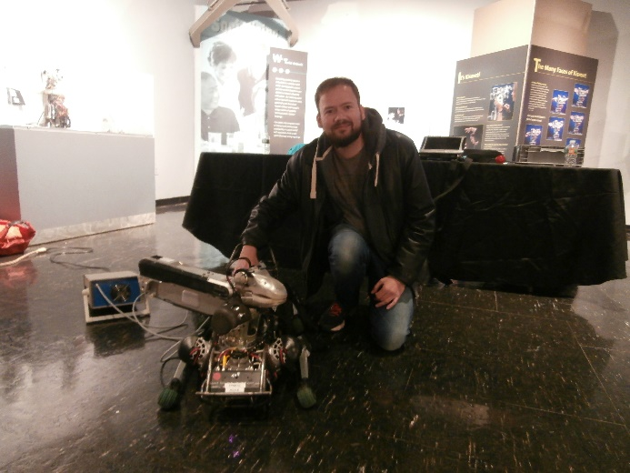
Meet the Team
Aymeric Weinbach
@aymericw

Slide 3
Au programme
L’IoT ?
Robots
Prototypez vos objets connectés
Les services Azure IoT
AI

Slide 4

L’IoT ?

Slide 5
Harnessing the IoT Revolution
  What if my things could tell me when they go someplace they shouldn’t?
  What if I could use device telemetry to improve next generation devices?
  It all starts with a great idea…
  What if I knew when my things were going to break before they did?
  What insights could I find from all of my devices?
  What if I simply knew where my things were?
  What if I could tell when it’s the best time for my things to _______ ?

Slide 6
Prototyping

Slide 7
La nécessité de prototyper
Cout d’un oubli ou d’un bug coté cloud :
corriger le bug , commit, push, build, deploy ( cout : 3 clics et un café)
Cout d’un oubli ou d’un bug coté device :
Hardware : refaire tous les devices
Software : Mise à jour de firmware (est ce que c’est prévu)
Dans les 2 cas trés cher $$$

Slide 8
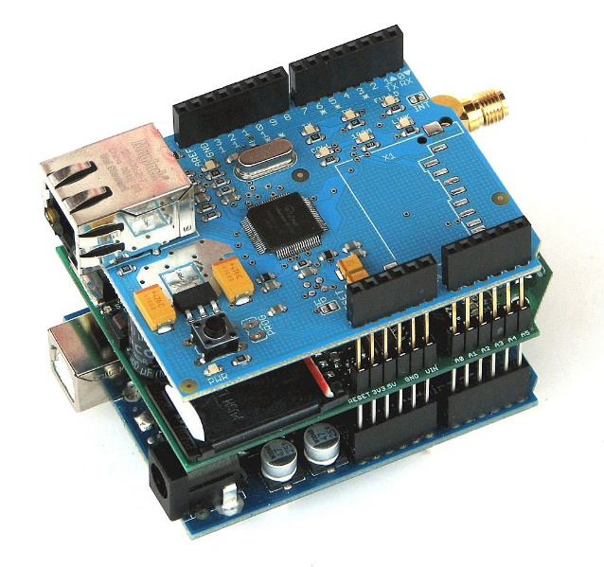
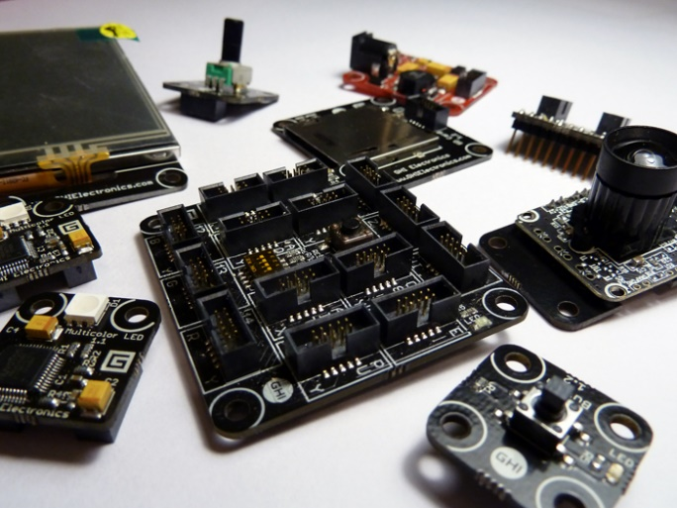
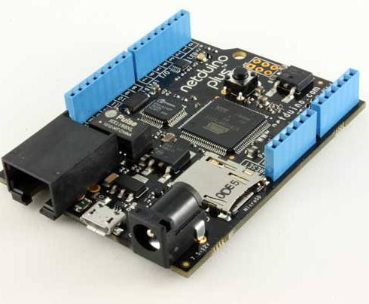
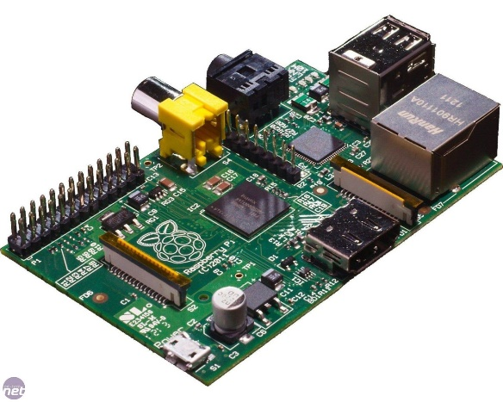
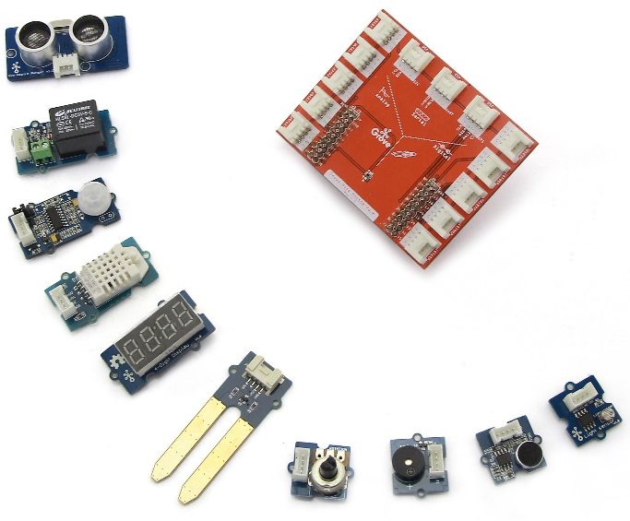
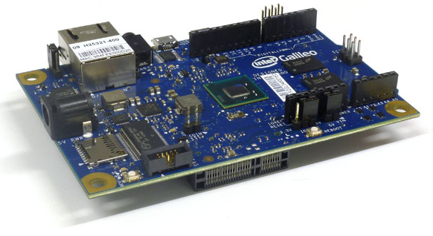
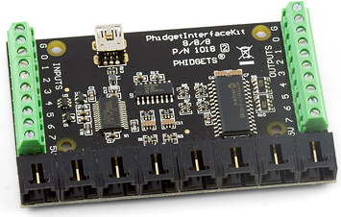
Choisir une plateforme de prototypage
Gadgeteer
Arduino
Netduino
Galileo
Kit Grove
Raspberry Pi
Phidget

Slide 9
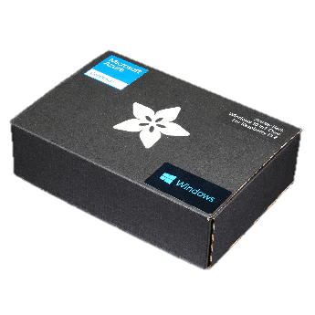
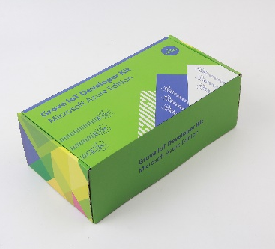
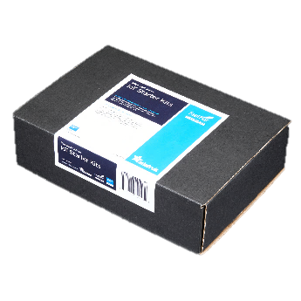
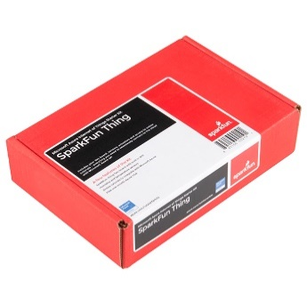

Azure IoT Starter Kits
Get started quickly
Raspberry Pi 2 Kit
Windows 10 and Raspbian
Samples in C and C#
Intel Edison Kit
Linux Yocto
Samples in JavaScript (Node.js)
Feather M0 Wi-Fi Kit
RTOS
Samples in Arduino IDE and C
ThingDev Kit
RTOS
Samples in Arduino and C
Feather Huzzah ESP8266 Kit
RTOS
Samples in Arduino IDE and C
Start today: http://azure.com/iotstarterkits

Slide 10

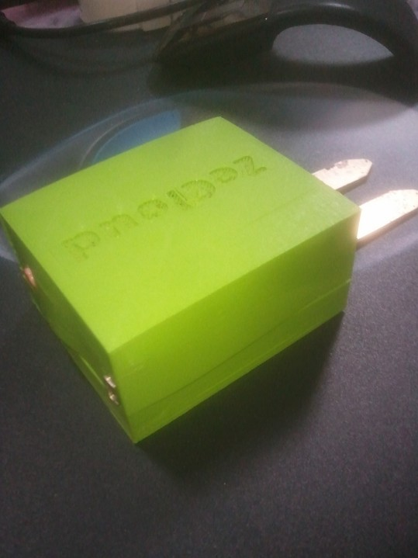
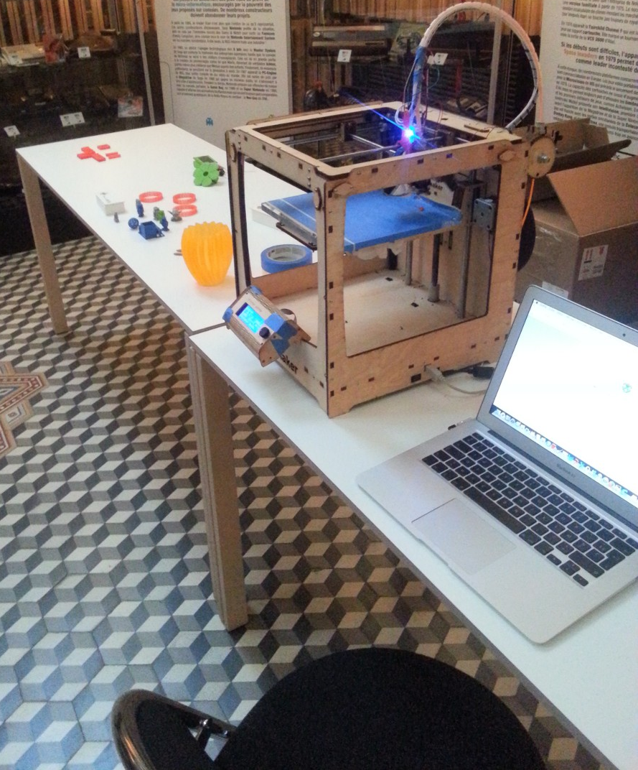
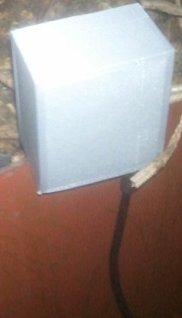
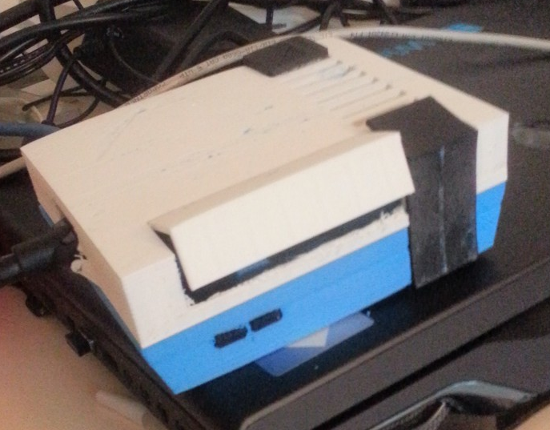
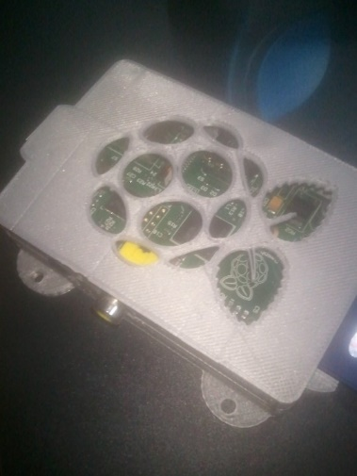
imprimante 3D

Slide 11
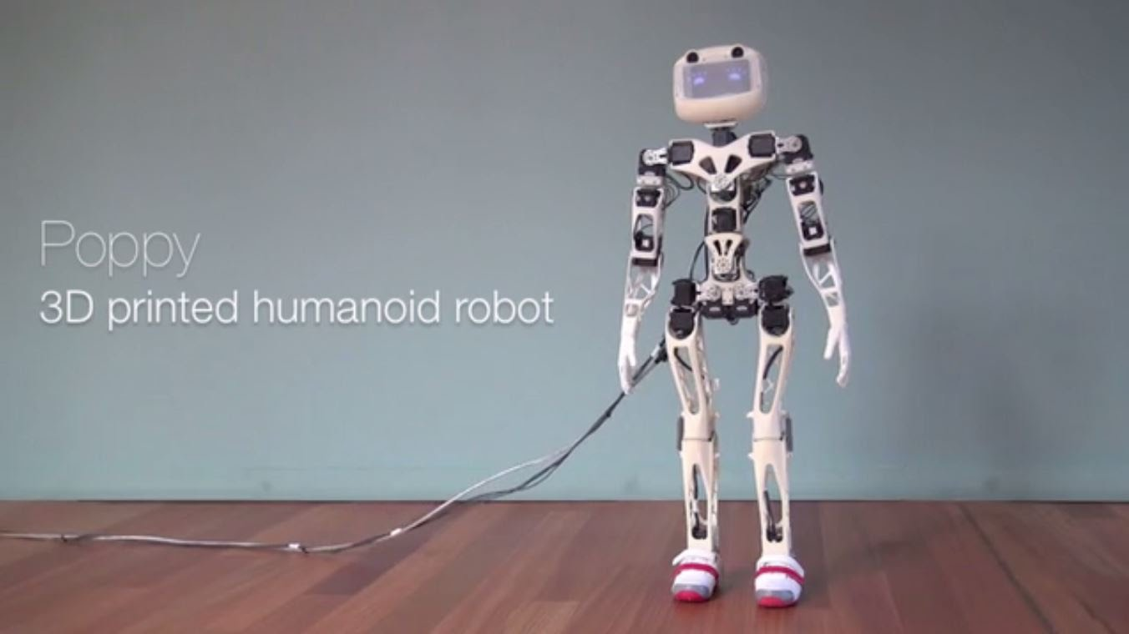

Slide 12
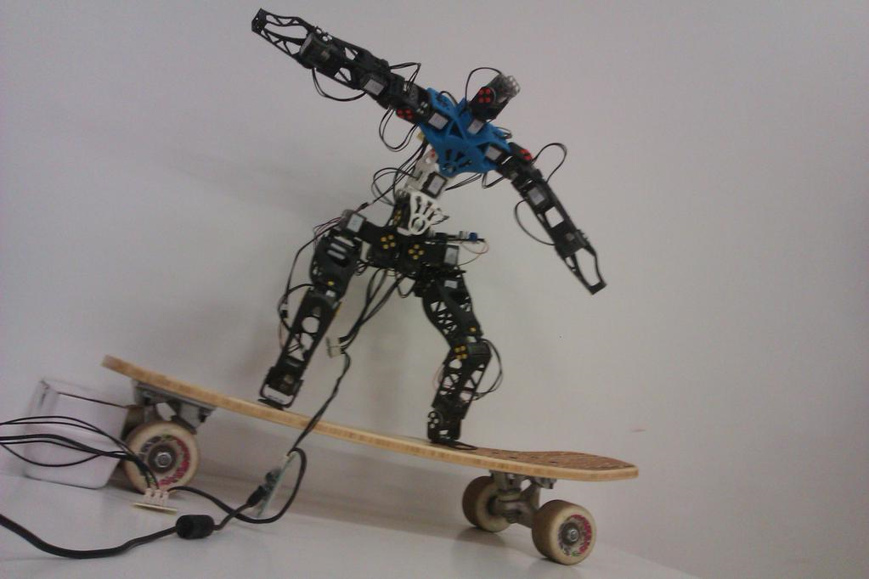
Objectif Robot connecté et intelligent

Slide 13


Slide 14

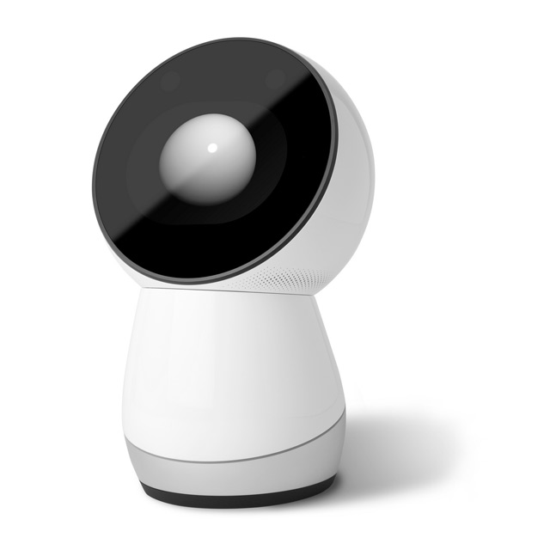

Social Robot

Slide 15
Azure IoT

Slide 16
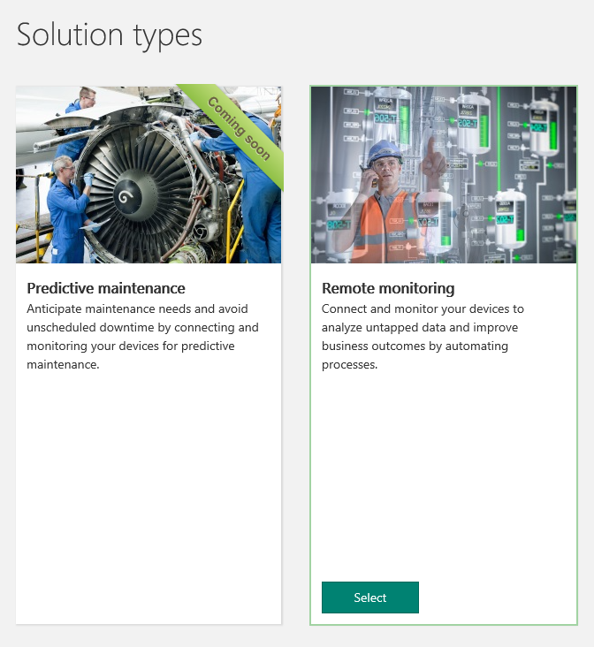
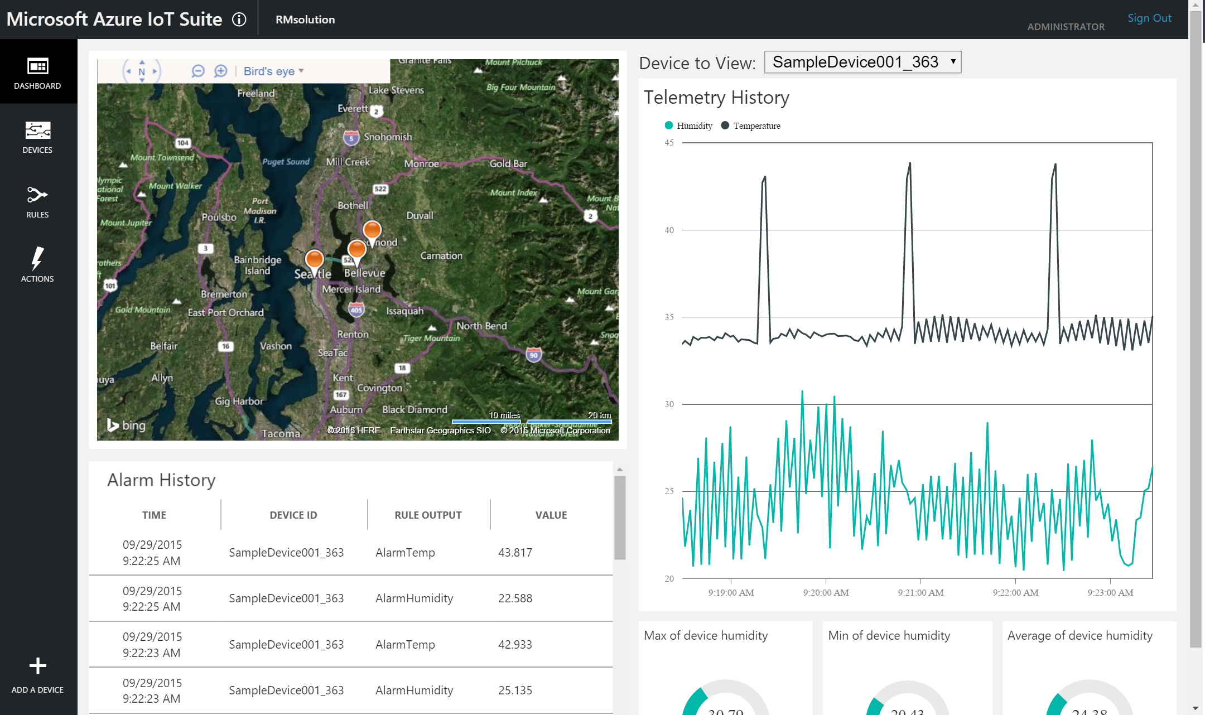







Microsoft Cloud offer for IoT
Predictive
maintenance
Azure IoT Suite
Azure services (IoT and others)
Asset
management

Slide 17
Azure Services for IoT
Azure IoT Hub
  Connect, secure, communicate, monitor and manage billions of devices
Azure Stream Analytics
  Real time stream processing for billions of IoT devices
Azure Storage
  Blob, SQL, DocumentDB, Data Lake. Storage to meet every need at the scale of IoT
Azure App Service
  Web and mobile apps for any platform on any device
Power BI
  Dashboards and data connectors to visualize any data
And More…

Slide 18











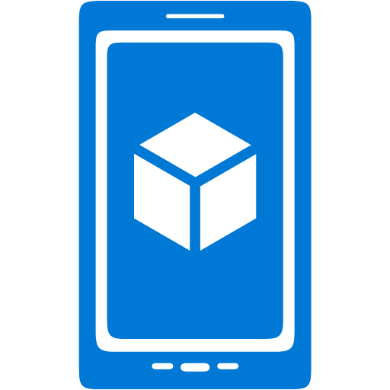











































Platform Services
Security & Management
Services Compute
Web and Mobile
Data
Hybrid
Operations
Cloud
Services
Service
Fabric
Web Apps
API Apps
Portal
SQL
Database
Data
Warehouse
DocumentDB
Azure AD
Health Monitoring
Azure Active
Directory
Batch
RemoteApp
AD Privileged
Identity
Management
Mobile
Apps
Logic Apps
Redis
Cache
Azure
Search
Storage
Tables
Azure AD
B2C
Integration
Domain Services
Multi-Factor
Authentication
API
Management
Notification
Hubs
Storage
Queues
BizTalk
Services
Analytics & IoT
Backup
Automation
Hybrid
Connections
Service Bus
Developer Services
HDInsight
Machine
Learning
Stream
Analytics
Data
Lake
Operational
Analytics
Scheduler
Key Vault
Visual Studio
Azure
SDK
Data
Factory
Event
Hubs
Data
Catalog
Import/Export
Media & CDN
Store/
Marketplace
Media
Services
Content
Delivery
Network (CDN)
VS Online
App
Insights
Mobile
Engagement
Azure Site
Recovery
IoT Hub
VM Image Gallery
& VM Depot
StorSimple
Infrastructure Services
OS/Server Compute
Storage
Networking
Virtual Machines
Container
Service
BLOB Storage
Azure
Files
Premium
Storage
Virtual Network
Load Balancer
DNS
Express
Route
Traffic Manager
VPN Gateway
App
Gateway
Datacenter Infrastructure (30 Regions, 22 Online)

Slide 19
Architecture Lambda
Events
Near
Real Time
DB
SQL/noSQL
query
&
merge
storage
batch
Storage, DB

Slide 20
Azure IoT Suite
Get started in minutes & customize to meet your needs
Remote Monitoring Service Architecture
Devices
Azure IoT SDK (OSS)
Linux, RTOS, mBed, Windows,
Android, iOS
Business Process
ERP/CRM
Web App
Storage Blobs
DocumentDB
IoT Hub
Stream Analytics
Event Hub
Web Jobs
Logic Apps
Azure
Active Directory

Slide 21
Azure IoT Hub
Designed for IoT
  Connectivity, Security & Management for billions of devices
Service Assisted Communications
  Devices are not servers
  Use IoT Hub to enable secure bi-directional communications
Cloud Scale Messaging
  Device-to-cloud and Cloud-to-device
  Durable message inbox/outbox per device
Monitor Devices
  Delivery receipts, expired messages
  Device communication errors
Per-Device Authentication
  Individual device identities and credentials
Connection Multiplexing
  Single device-cloud connection for all communications
  (device-to-cloud, cloud-to-device)
Multi-Protocol
  Natively supports AMQPS, HTTPS, MQTT
  Extensible protocol support for custom protocol needs
Multi-Platform
  Device SDKs available for multiple platforms
  RTOS, Linux, Windows, iOS, Android
  Service SDK supports multiple languages (Node, Java, C#)

Slide 22
Pick your favorite to create a hub
Azure Portal
  https://portal.azure.com
ARM template
  https://azure.microsoft.com/en-us/resources/templates/
Azure CLI
  https://github.com/Azure/azure-cli (v2.0 Python)
  https://github.com/Azure/azure-xplat-cli (v1.0 Node.js)
Powershell
  https://docs.microsoft.com/en-us/powershell/azureps-cmdlets-docs/

Slide 23

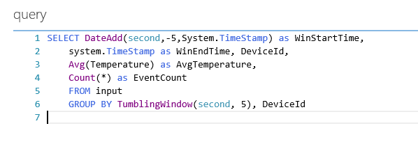
Stream Analytics
Azure Stream Analytics
Outputs
SQL Azure
Azure Blobs
Event Hub
Temporal Semantics
Guaranteed delivery
Guaranteed up time
Transform
Temporal joins
Filter
Aggregates
Projections
Windows
Etc.
Enrich
Correlate

Event Inputs
Event Hub
Azure Blob
BI
Dashboards
Predictive Analytics

Reference Data
Azure Blob
☁
Azure
Storage
Data Source
Collect
Process
Deliver
Consume
Notes:
T

Slide 24
Azure IoT Recent Innovations
Security Program for Azure IoT
Azure IoT Hub Device Mgmt.
Azure IoT Hub Device Provisioning
Azure IoT
Edge
Microsoft IoT
Central
Matchmaking with IoT security auditors
Cross platform and fully extensible at scale
Cross platform and fully extensible at scale
Cross platform and open source
Fully managed and hosted IoT SaaS
Security Partnerships /DICE
Azure IoT Hub message routing
Azure IoT Suite connected factory
Azure Stream Analytics for Edge
Azure Time Series Insights
Secure hardware attestation for constrained devices
Simple, powerful, declarative
Pre-configured Solution for Insights from OPC installations
Complex event processing on Azure IoT Gateway SDK
Fully managed Time Series Store and UX

Slide 25
Some developers tools
IoTHub-explorer : node based CLI
  npm install -g iothub-explorer
Device Explorer: Windows app
  Installer in releases of github.com/azure/azure-iot-sdk-csharp
Device discovery CLI
  npm install -g device-discovery-cli
IoTHub Diagnostics tool
  npm install -g iothub-diagnostics
Azure IoT Toolkit Extension for Visual Studio Code
  Look for « Azure IoT Toolkit » in the VS Code extensions library
Arduino Extension for Visual Studio Code
  Look for « Arduino » in the VS Code extensions library

Slide 26
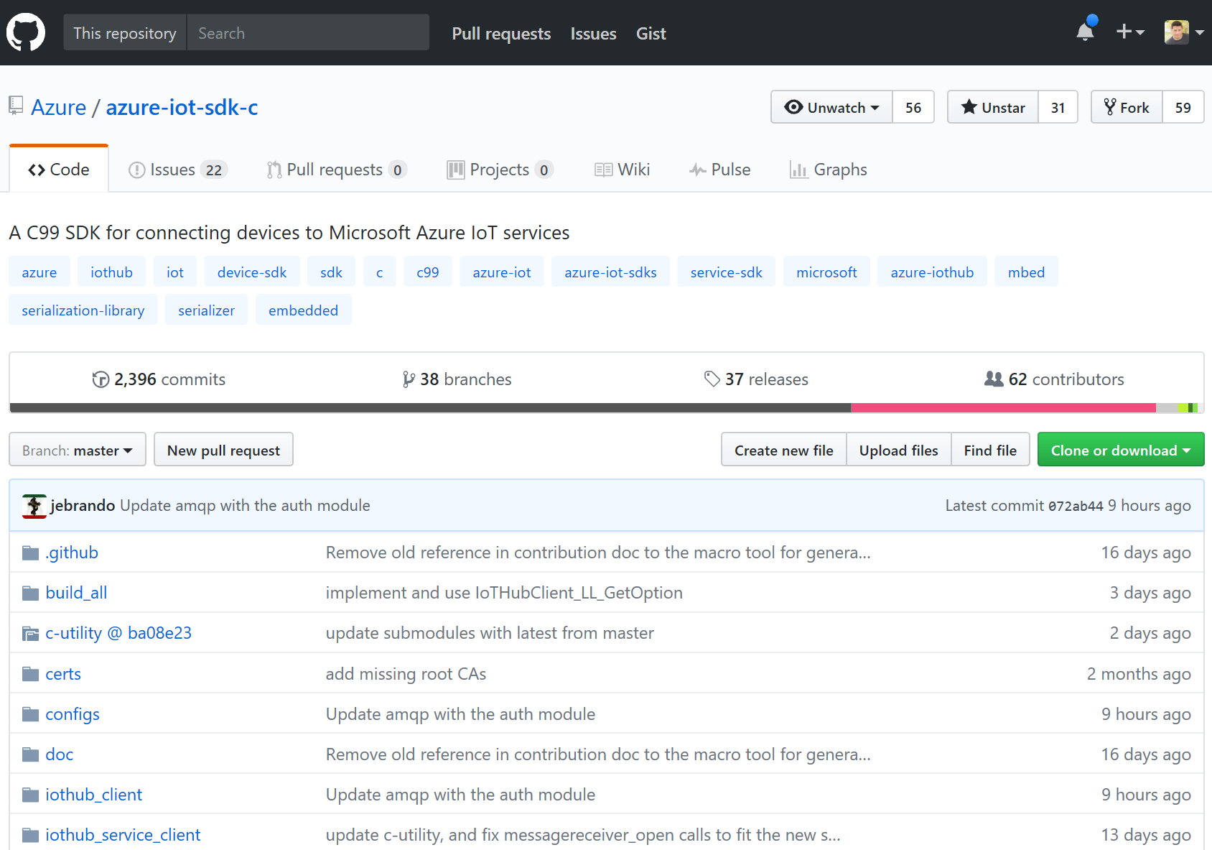
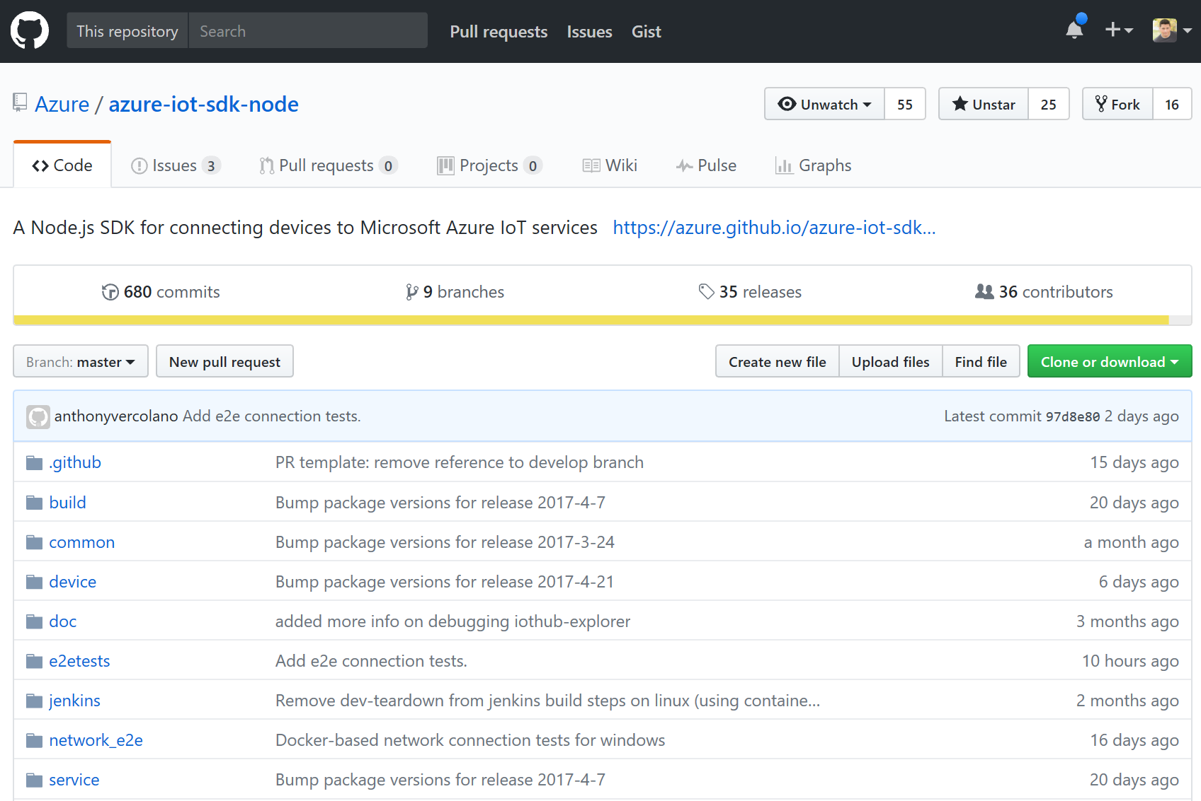
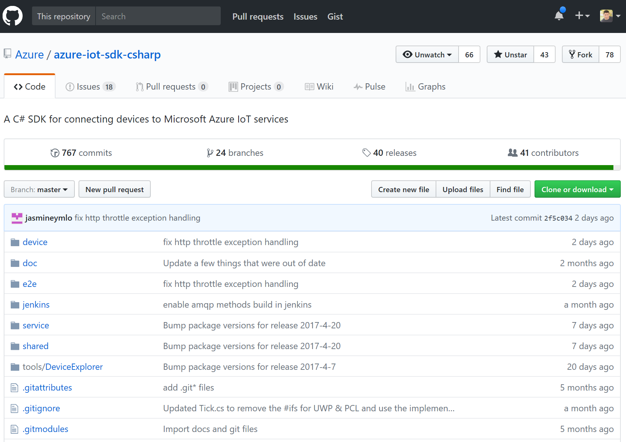
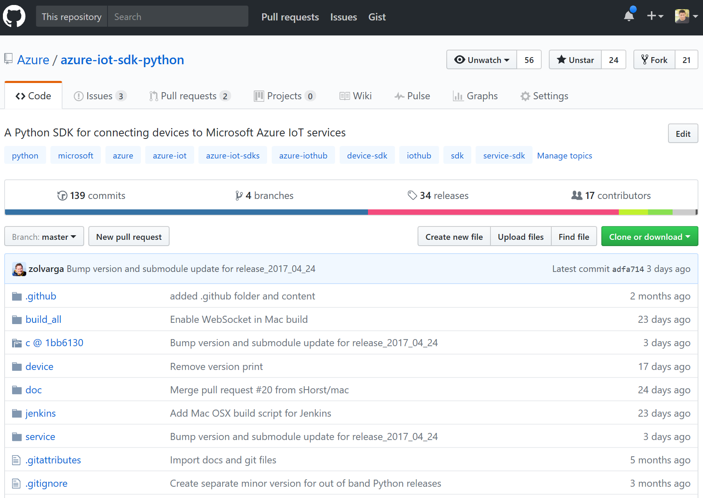
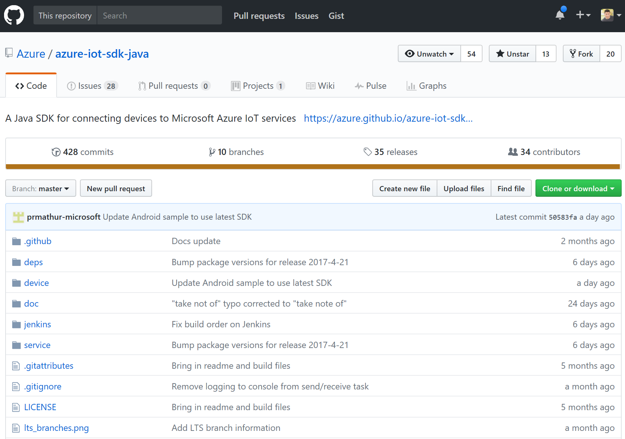
Open Source SDKs

Slide 27
Packages and libraries
Maven
  Java
PyPI
  Python
Arduino lib
Mbed lib
NuGet
  C on Windows
  .Net
Apt-get
  C on Linux (Ubuntu/Debian)
Npm
  Node.js

Slide 28
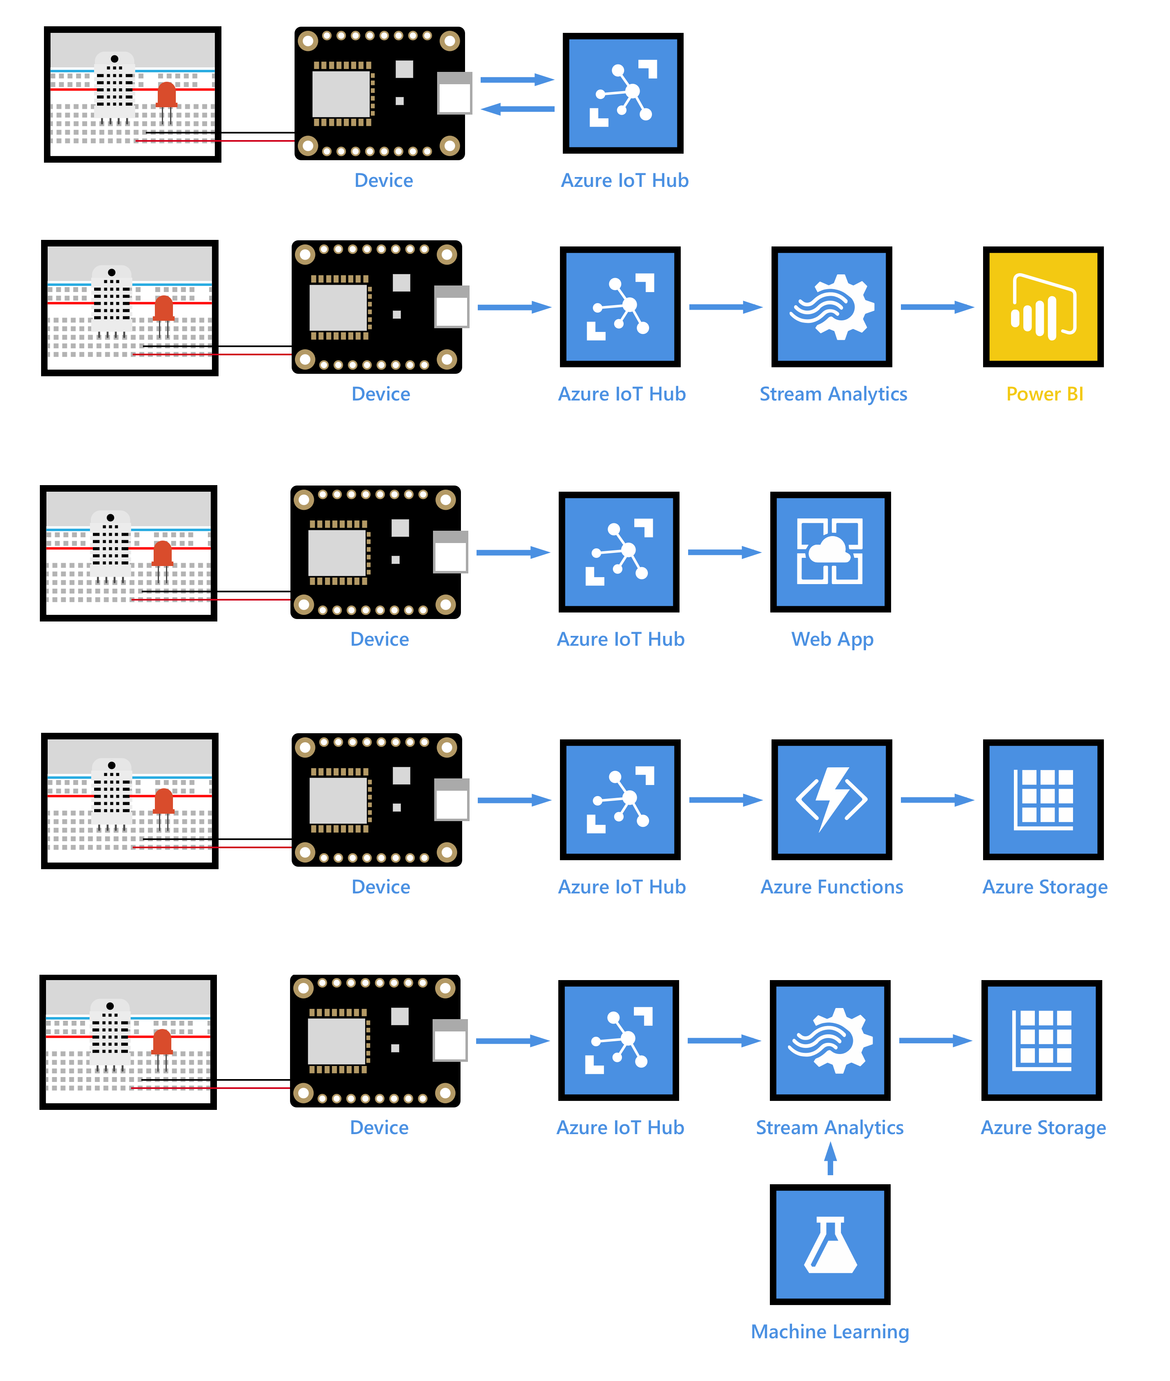
Step-by-step tutorials
Learn more: https://aka.ms/azureiotgetstarted

Slide 29
Artificial Intelligence

Slide 30

AI for All
Microsoft Cognitive Services

Slide 31



Cortana Intelligence Suite
Information Management
Big Data Stores
Machine Learning and Analytics
Intelligence
Data
Sources
People
Data Factory
Data Lake Store
Machine Learning
Cognitive Services
Data Catalog
SQL Data
Warehouse
Data Lake Analytics
Bot
Framework
Web
Apps
HDInsight
(Hadoop and Spark)
Event Hubs
Cortana
Mobile
Apps
Stream Analytics
Bots
Dashboards & Visualizations
Sensors
and
devices
Power BI
Automated
Systems
Data
Intelligence
Action
http://www.microsoft.com/en-us/server-cloud/cortana-intelligence-suite

Slide 32
Machine Learning services in the cloud
Machine Learning
Algorithms
Best of Microsoft
Azure Machine Learning
CNTK
Modelling and Operationalization
Data Scientist
IT Pro
Microsoft Cognitive Services
APIs
Developers
Notes:
So if we wanted to provide one structured view of our Machine Learning offer
At the top, you have the Machine Learning Algorithms – best-in-class ML Algorithms and models made by Microsoft over the last few years from Bing, to Cortana, XBOX, DELVE on Office 365…
[click] Machine Learning Studio

Slide 33
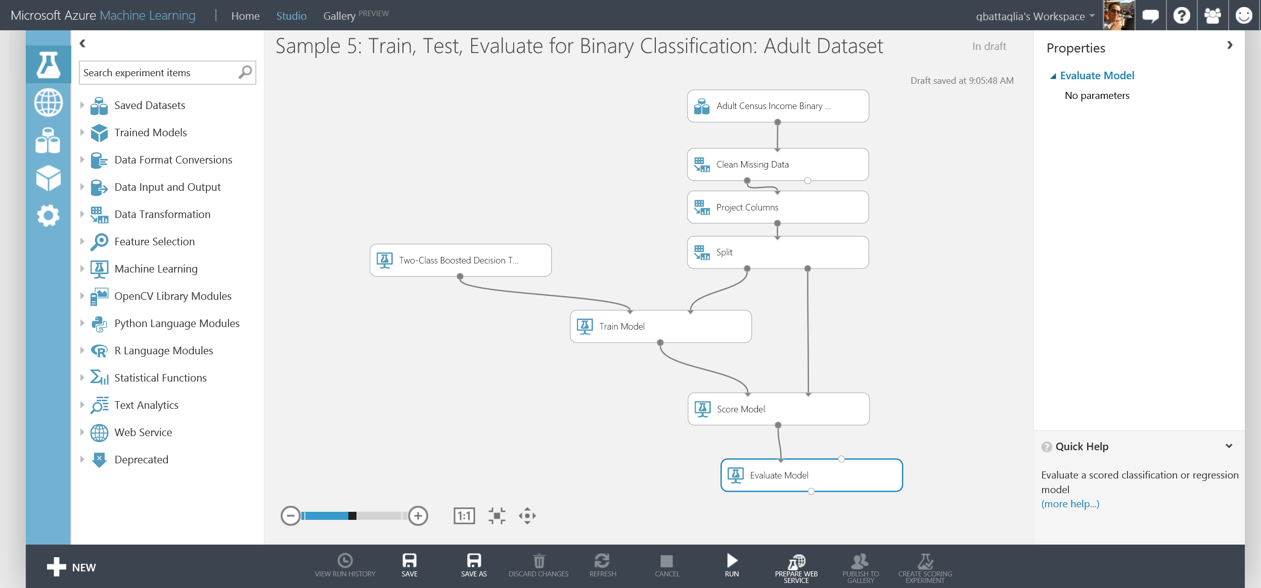
Machine Learning services in the cloud
Notes:
Next, the Machine Learning Studio: an easy to use solution accessible in your BROWSER, Very INTUITIVE, for quick building and experimenting with predictive models. → Audience: Lowering the entry barrier for Data Scientists
[click] Machine Learning Operationalization

Slide 34

Microsoft Cognitive Services
Vision
From faces to feelings, allow your
apps to understand images and video
Cognitive
Services
Give your solutions
a human side
Speech
Hear and speak to your users by filtering noise, identifying speakers, and understanding intent
Language
Process text and learn how to recognize what users want
Knowledge
Tap into rich knowledge amassed from
the web, academia, or your own data
Search
Access billions of web pages, images, videos, and news with the power of Bing APIs
Notes:
What are Cognitive Services? Microsoft Cognitive Services are a new collection of intelligence and knowledge APIs that enable developers to ultimately build smarter apps.

Slide 35

Smarter robots with Cognitive Services
VISION
SPEECH
LANGUAGE
KNOWLEDGE
SEARCH
Recognize people and things
Give me
directions to
El Gaucho
Play today’s
Daily Show
Show me the top
economics
journals
Search for
‘cute kittens’
Computer vision
Speech-to-text
and text-to-
speech service
Natural language processing
Knowledge
exploration service
Bing search

Slide 36

microsoft.com/cognitive
Vision
Speech
Language
Knowledge
Search
Computer Vision
Custom Recognition
Bing Spell Check
Academic Knowledge
Bing
Web Search
Emotion
Speaker Recognition
Linguistic Analysis
Entity Linking
Bing
Image Search
Face
Speech
Language Understanding
Knowledge Exploration
Bing
Video Search
Video
Text Analytics
Recommendations
Bing
News Search
Content Moderator
WebLM
QnA Maker
Bing
Autosuggest
Translator

Slide 37









Why Microsoft
Cognitive Services?
Easy
Flexible
Tested
Roll your own with REST APIs
Simple to add: just a few lines of code required
Integrate into the language and platform of your choice
Breadth of offerings helps you find the right API for your app
Built by experts in their field from Microsoft Research, Bing, and Azure Machine Learning
Quality documentation, sample code, and community support
GET A
KEY
BUILD

Slide 38








Analyze image
Vision APIs
Category | People; 1 face found
Adult / Racy? | False / True
Black & White? | No
Dominant colors
Accent color
Analyze an Image – Understand content and features within an image for a growing set of categorization
  Wide range of concepts from cat to fireworks
OCR – Detect and recognize words within photos or scanned documents
Generate Thumbnail – Scale and crop an image, while retaining key content
Powers Bing Image search and OneDrive.com Photos
OCR
  Recognized text:
  A GOAL WITHOUT
  A PLAN IS
  JUST A WISH
Smart thumbnail
Notes:
Examples – Useful for moderating UGC

Slide 39


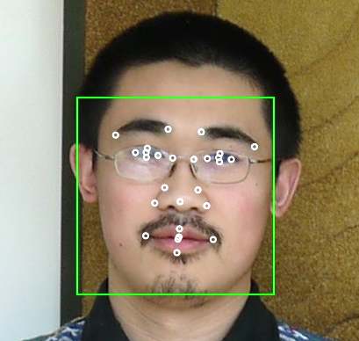




























Detection Result
Face APIs
Face Rectangle – width; height; left; top
Attributes:
  Age – 31
  Gender – Male
Face Landmarks –pupil, nose, mouth
DETECTION
ATTRIBUTES
INPUT
IMAGE
Face Detection – Detects faces and their attributes within an image
Face Verification – Check if two faces belong to the same person
Similar Face Searching – Find similar faces within a set of images
Face Grouping – Organize many faces into groups
Face Identification – Search which person a face belongs to
Models used to power Microsoft Skype & Windows Hello
Grouping
Identity
He is Chao Wang…
IDENTIFY
Natalie Huber
NEW INPUT
IMAGE
RECOGNITION
Chao Wang
COLLEAGUES

Slide 40


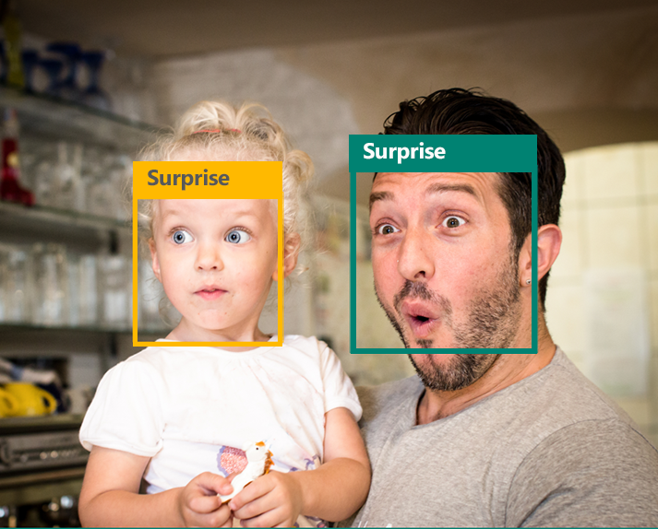
Emotion APIs
Identifies emotions based on expressions that psychologic research identifies as universal: Happiness, Surprise, Sadness, Anger, Fear, and Disgust
Has been trained to identify emotions in-the-wild.
A solution for analyzing individual responses to media and products, to crowd analytics, and to enhanced personalization
Get insights into how your users react to content and experiences
Track facial expressions for multiple users over time.

Slide 41


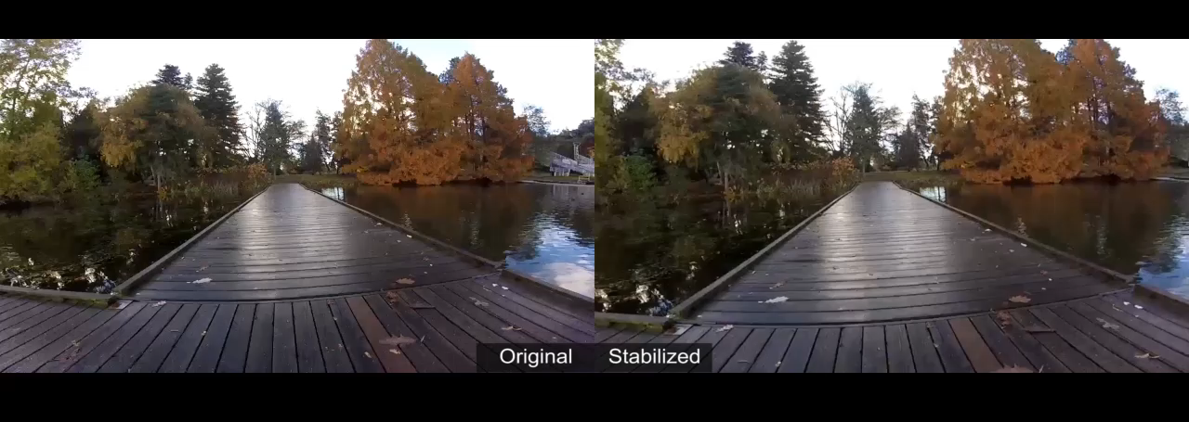
Video APIs
Stabilization – Smooth and stabilize shaky video
Face Detection and Tracking – Detect and track faces in videos
Motion Detection – Detect when motion occurs

Slide 42



Speech APIs
State of the art algorithms to process spoken language
Voice Recognition – Converts spoken audio to text
  Support for 18 languages (28 locales)
Voice Output – Synthesize audio from Text
  Support for 9 languages (17 locales)
Powered by Bing, which is the same backend for Xbox and Cortana on Windows Phone 8.1 and Windows 10
  Speech
  Recognition
  Speech Intent Recognition
  Text to Speech Conversion
450 6th St.
San Francisco
  "450 sixth St in San Francisco."
  "For 50 six St San Francisco."
  "456th St San Francisco."
Convert spoken audio to text
Convert audio to intent
Convert text to spoken audio

Slide 43

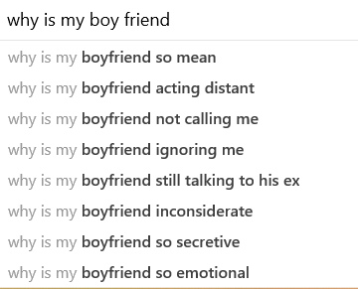
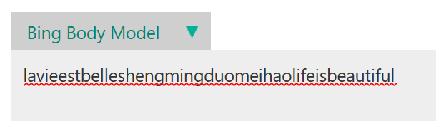
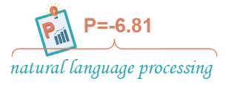
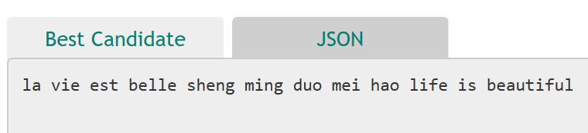
Web Language Model API
Language models from the web
Capturing distinct expression styles
  Text body
  Titles
  Search queries
Essential component for
  New lexicon discovery
  Key phrase extraction
  Auto completion
  Word/phrase breaking
  Speech/Handwriting recognition
  OCR
  Spelling correction
New York times square report
?
Evaluate Frequencies
Predict likely next
Adapt to new corpus*
Notes:
Examples:
Acoustic models can be trained to better understand children voices
Language models can be trained to understand domain specific terms

Slide 44
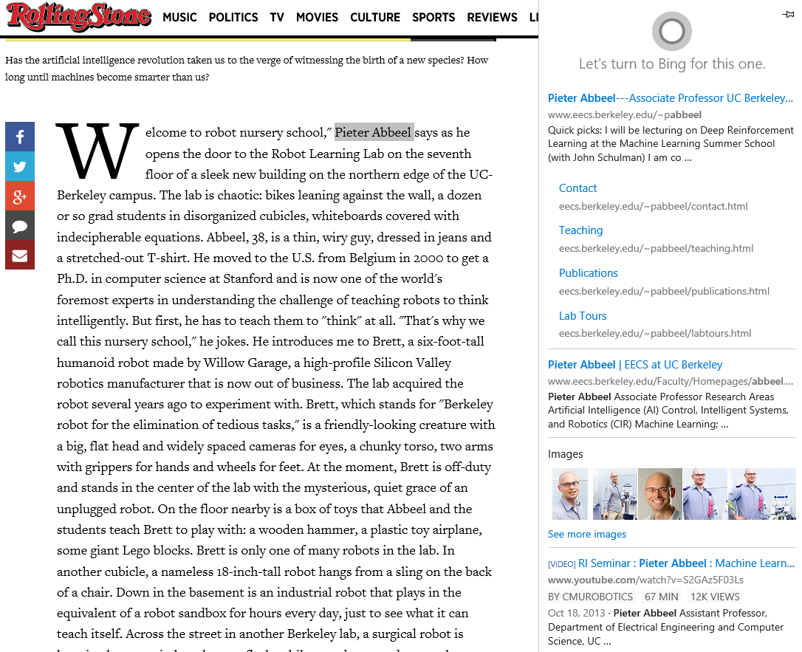
Entity Linking Service
Read text document and identify mentions of people, locations, events and things (“entities”)
Disambiguate mentions in context and link them to a give knowledge base
Backend API powering
  Edge browser: “Ask Cortana”
  Android: “Bing Snapshot”
Available
  Now: Wikipedia
  Later: Bing Satori Knowledge
Adaptable to enterprise data

Slide 45
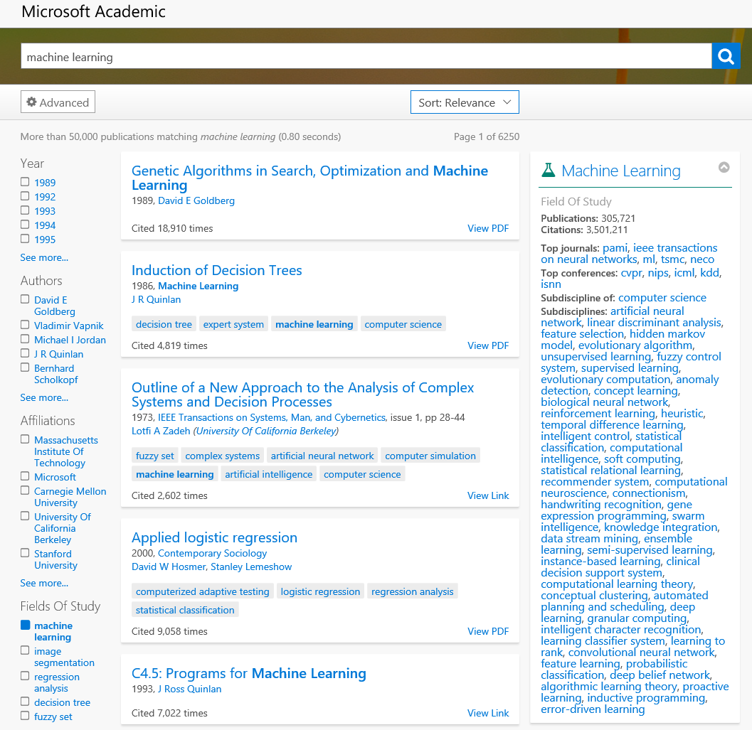
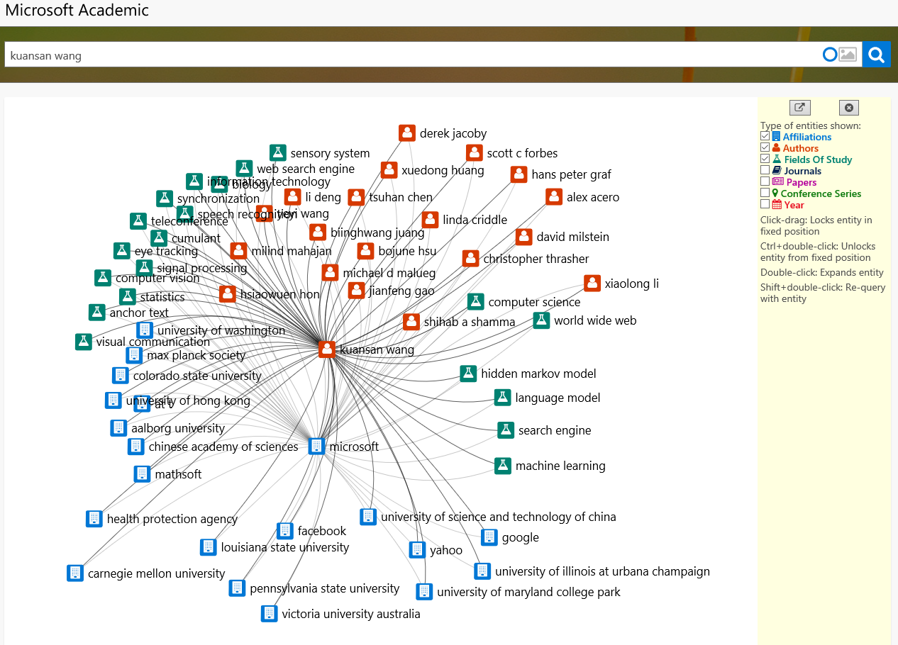

Knowledge Exploration Service (KES)
Draw insights from your data
Search and Browse
Rank and Recommend
Showcase: Academic Knowledge API = KES + academic graph
  What are top publications for a subject?
  Who are the experts?
  Where are the activities taking place?
  Who are working with whom on what?
  When was the work done?
  What are the new trends?

Slide 46
Bing Custom Search
Custom Vision Service
Custom Decision Service
Cognitive Service Labs
Nouveautés de la Build

Slide 47
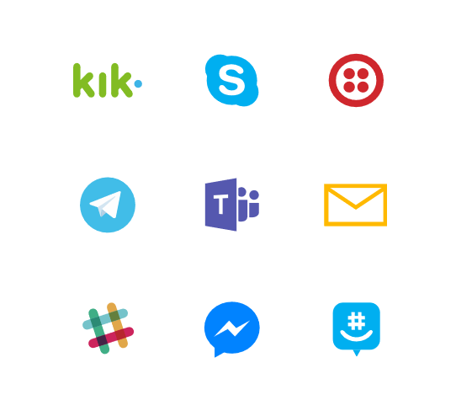
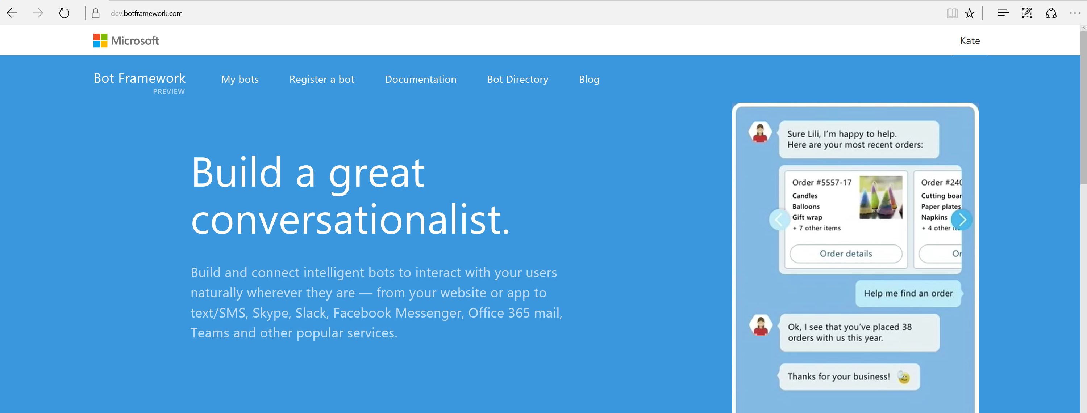
Bot Framework
Notes:
67,000 developers to date building bots since launch a year ago.
Write once and use our bot connector to connect wherever your users are – Facebook, Slack, Skype or SMS, and your own websites.
Available as open source on GitHub and integrated in Azure via the bot service.
That said, bots themselves are just pieces of software. So, how do you make them smart? Cognitive…

Slide 48

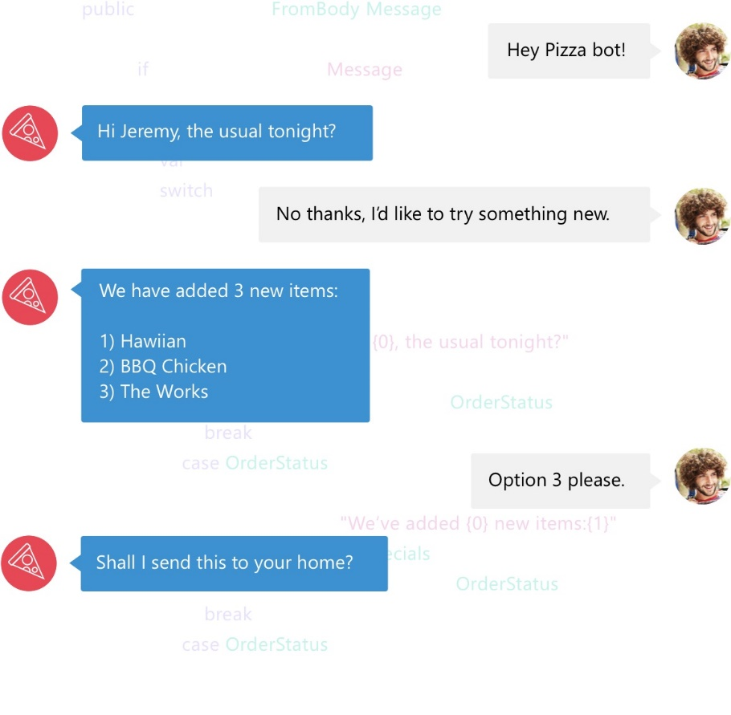

Slide 49



Nous suivre
Facebook
LinkedIn
facebook.com/groups/azugfr/
Linkedin.com/inspirasign
Twitter
Web
twitter.com/AZUGFR
www.azug.fr
Meetup
meetup.com/AZUG-FR/

Slide 50
Merci
d’être venus
A bientôt !

