Slide 1
Rencontrez TJBot,
un robot cognitif, programmable et fun !
#IBMCloud #Watson #BOT
Clemence Lebrun,
Developer Advocate at IBM
June, 2018

Slide 2
Clemence Lebrun, Developer & Developer Advocate Europe
IBM Cloud
clemence.lebrun@fr.ibm.com | @ClemenceLebron | cllebrun

Slide 3
Hello, my name is TJBot !

Slide 4
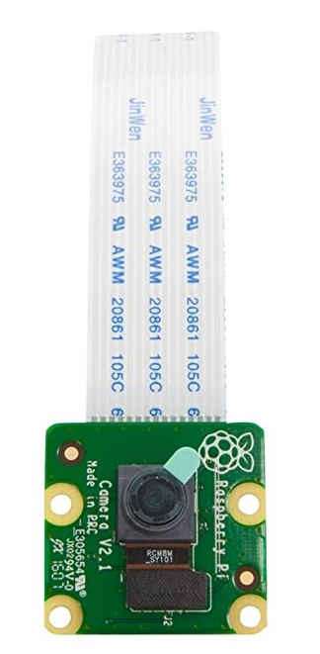
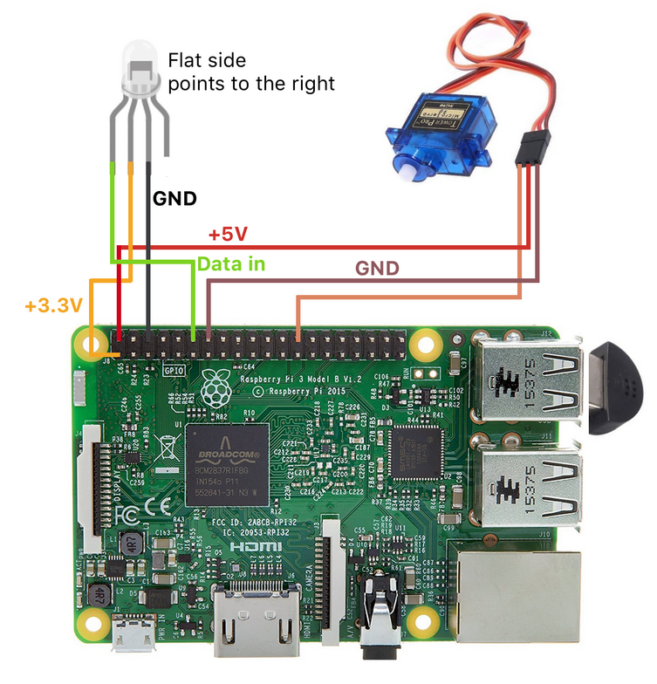
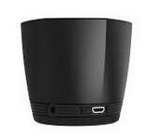
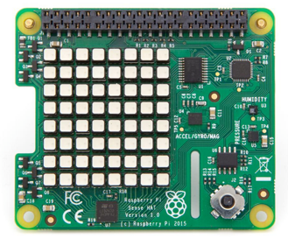
Build TJBot
5
4
6
- Raspberry Pi (3 Model B) + SD Card
- Raspberry Pi Camera
- USB Microphone
- Speaker (USB or Bluetooth)
- Servo Motor
- RGB LED
- Wires
- SenseHat (optionnal)
7
2
3
1
8

Slide 5
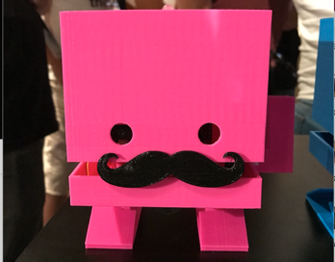
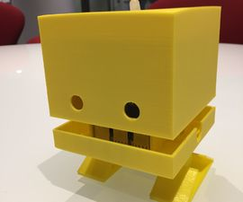
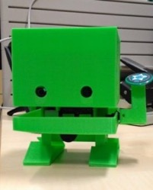
Design your own !
Using laser cut…
… or a 3D printer !
Download design files at https://ibmtjbot.github.io/
Notes:
http://www.instructables.com/id/Build-TJ-Bot-Out-of-Cardboard/

Slide 6
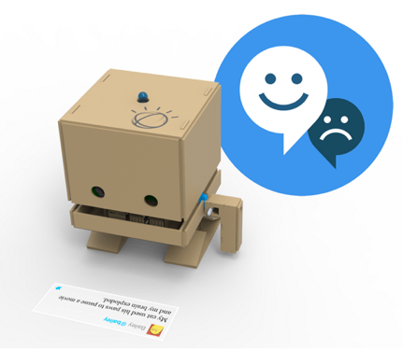
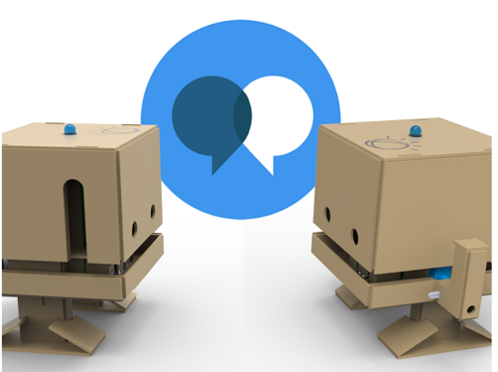
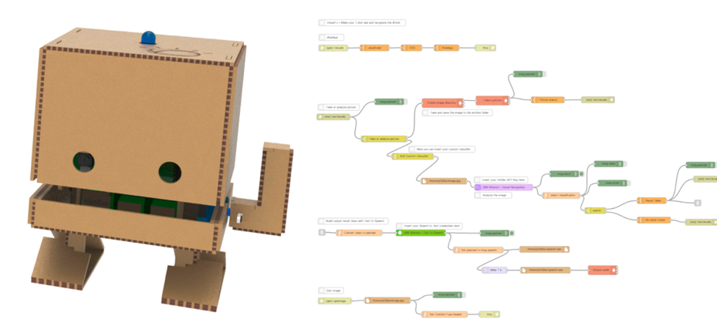
Bring TJBot To Life
Using Watson Services
Have some fun and code your own AI robot experimenting IBM Watson services. Get started with easy, step-by-step Instructions and pre-written recipes to bring TJBot to Life.
https://www.ibm.com/watson/
Using Node-RED
Node-RED is a programming tool for wiring together hardware devices, APIs and online services in new and interesting ways
You can use nodes such as Watson nodes, Raspberry Pi nodes, Twitter node, Node-RED dashboard …
Text
To
Speech
Speech
To
Text
Watson
Assistant
Tone
Analyzer
Visual
Recognition
Notes:
https://github.com/ibmtjbot/tjbot
https://www.instructables.com/member/TJBot/

Slide 7
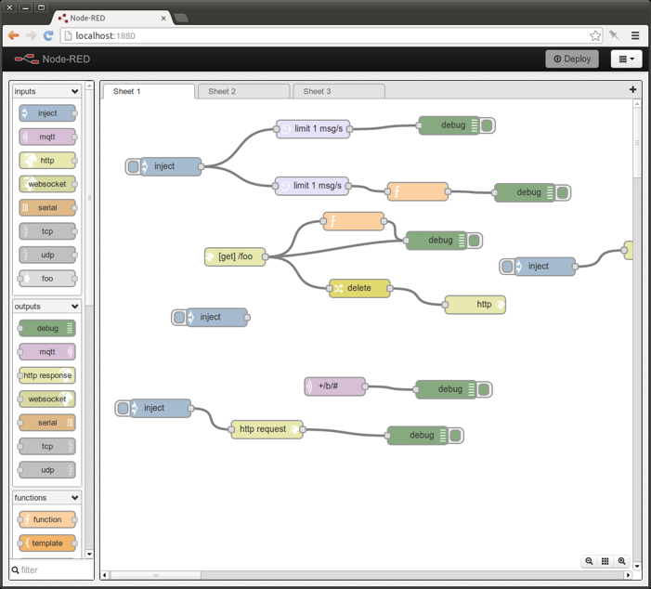
Node-RED makes it easy to wire together the IoT
“A visual tool for wiring the internet of things”
It provides a browser-based UI for creating flows of events and deploying them to the runtime.
Light-weight runtime, built in node.js,
Ideal for edge-of-network environments or running in IBM Cloud
It can be easily expanded by adding new nodes to its palette – taking full advantage of the node package manager (npm) ecosystem

Slide 8
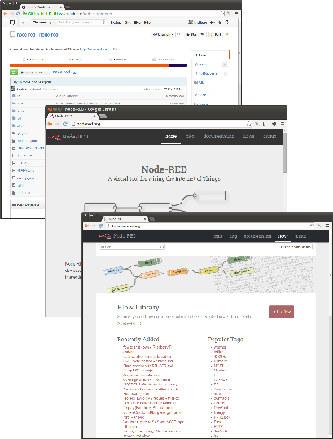
Open Source Development
IBM-originated (Hursley labs, UK)
- Released on GitHub September 2013
- Now part of the JS foundation
- Main site: http://nodered.org
Custom nodes ecosystem
http://flows.nodered.org
Over 1400 nodes available
Flow library
Encourages sharing and reuse of flows within the community

Slide 9
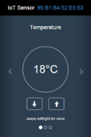
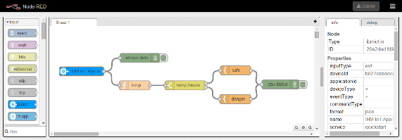
Watson Internet of Things Platform Boilerplate
IBM Cloud Watson IoT Platform Starter Kit Boilerplate for getting going quickly
For use with real devices or simulators
Node-RED editor and runtime customised with WIoTP nodes in its palette
Configuration and Flows are persisted in a Cloudant database

Slide 10
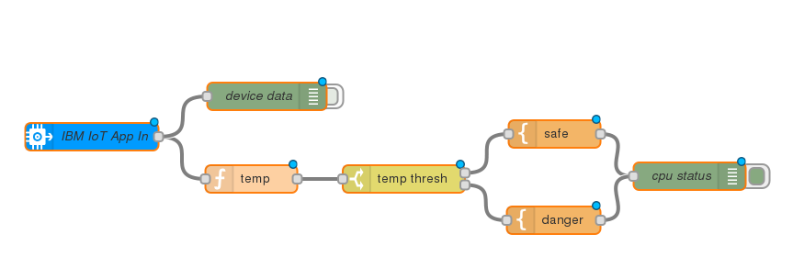
Node-RED Flows and Nodes
These wires are attached to the same terminal, so output from “IoT App in” is copied to both receiving nodes
Input node: reads events from WIoTP
Switch node: routes incoming messages to one or more of its output terminals
Debug node: writes output to debug window
Node-RED implements a graphical Data Flow language.
Flows can be imported or exported as JSON objects

Slide 11
Nodes on Node-RED
Node-RED has essentially three types of node:
Input nodes
Output nodes
Processing nodes

Slide 12
Input nodes
Allows data to be injected into the flow:
- Manually
- From an external source
Input nodes have only output pins

Slide 13
Output nodes
Allow sending of data outside the flow:
- To external sources for example email, web sockets
- To the debug pane
Output nodes have only input pins

Slide 14
Processing nodes
Allow processing of data:
- Transform the data
- Trigger messages
- Write custom code
Watson APIs
Processing nodes have at least one input pin and at least one output pin

Slide 15
Flows in Node-RED
Flows consist of multiple nodes wired together
- Nodes produce and consume messages
- Messages flow between the nodes

Slide 16
Messages in Node-RED
Messages are java script objects which have (by default) three attributes:
- payload
- topic
- _msgid
Additional attributes may be added in the flow
- Data input to the flow automatically goes into the payload attribute

Slide 17
Inject nodes
Inject nodes may be used to manually inject a payload to test the flow
Clicking the activation button will inject the payload

Slide 18
Debug nodes
Debug nodes may be toggled on or off using their activation button
- Only active debug nodes output data to the debug pane
- Debug nodes may be configured to display specific attributes from the message - or the entire message
Entire msg object in JSON format
msg.payload

Slide 19
Importing and exporting flows
Flows may be imported or exported:
- To JSON formatted text
- To a library

Slide 20
Deploying flows
Flows must be deployed before they may be used
- Nodes that have changes yet to be deployed are given an icon as a visual reminder
- Deploying is extremely fast so a full deploy is usually recommended

Slide 21
Example: Change nodes
Change nodes are very powerful and allow you to manipulate, replace and even delete the message content
In this example the payload is a JSON object - the node takes some of those fields and adds them as attributes to the message itself
It then replaces the message payload with the contents of just one of those fields
The rules are processed in ordered sequence

Slide 22
Example: Switch nodes
Switch nodes allow you to redirect a message depending on some condition
In this example the message is sent to one of four output pins depending on the value of the lang attribute
Note that this is an additional attribute added to the message earlier in the flow

Slide 23
Example: Subflows - 1
Created from a selection
Instances of subflows become different tabs
Notes:
Subflows become new re-usable nodes in the pallette

Slide 24
Example: Subflows - 2
Subflows are nodes in their own right and may be instantiated many times

Slide 25
Data storage & scope
In addition to the msg object which passes between nodes there are other objects which may be used to store and retrieve data:
Context: the context object allows Function nodes (only) to store and retrieve data between invocations
For example to count how many times the function has been executed
Flow: the flow object allows any node in the flow (on a given tab*) to access the data stored within it
Global: available to all nodes across the canvas (on all tabs)
Notes:
*If you use subflows - globals must be used to shared data between them and other flows

Slide 26
Scope example

Slide 27
Watson & Node-RED

Slide 28
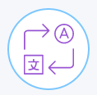
Watson services on IBM Cloud
Speech
Language
Empathy
AI Assistant
Vision
Knowledge
Data
Discovery
Watson Studio
Text To Speech
Language
Translator
Tone Analyzer
Watson
Assistant
Visual
Recognition
Watson
Machine
Learning
Natural
Language
Understanding
Speech To Text
Natural
Language
Classifier
Personality
Insights
Watson
Knowledge
Catalog
Knowledge
Studio
Notes:
Speech: Convert text and speech with the ability to customize models.
STT:
The Speech to Text service converts the human voice into the written word. It can be used anywhere there is a need to bridge the gap between the spoken word and their written form, including voice control of embedded systems, transcription of meetings and conference calls, and dictation of email and notes. This easy-to-use service uses machine intelligence to combine information about grammar and language structure with knowledge of the composition of the audio signal to generate an accurate transcription. (English (US), English (UK), Japanese, Arabic (MSA, Broadband model only), Mandarin, Portuguese (Brazil), Spanish, French (Broadband model only), Korean)
TTS:
The Text to Speech service processes text and natural language to generate synthesized audio output complete with appropriate cadence and intonation.
English (US) 2 female voices, 1 male voice (Watson’s voice from Jeopardy) English (UK) 1 female voice French 1 female voice German 1 female voice, 1 male voice Italian 1 female voice Spanish (Castilian) 1 female voice, 1 male voice Spanish (North American) 1 female voice Portuguese (Brazil) 1 female voice Japanese 1 female voice; Mobile SDKs (BETA) Mobile SDKs are now available to enable native interaction on iOS and Android devices.TTS customization API (BETA) Allows customers to create custom dictionaries containing their own word pronunciations for up to 20K words. Customization is currently available at no additional charge. SoftBank: A localized version of this Watson service is available in Japan. Visit the following link for details: http://www.softbank.jp/biz/watson
Language: Analyze text and extract meta-data from unstructured content.
NLC:
The Natural Language Classifier service applies cognitive computing techniques to return the best matching classes for a sentence or phrase. For example, you submit a question and the service returns keys to the best matching answers or next actions for your application. You create a classifier instance by providing a set of representative strings and a set of one or more correct classes for each training. After training, the new classifier can accept new questions or phrases and return the top matches with a probability value for each match.
Train and classify in multiple languages: English, Arabic, French, German, Italian, Japanese, Korean, Portuguese (Brazilian), and Spanish.
Classify natural language text: Train classifiers with text phrases, each with a maximum of 1024 characters
Leverage IBM Deep Learning as a Service during training: Each .csv file used in training can contain up to 20,000 records.
Create up to 8 classifiers with each Natural Language Classifier service instance
Multi-Category classification: Extract multiple categories from text phrases
Multi-Phrase classification: Classify up to 30 separate text phrases in a single request with the classify collection endpoint.
Language Translator:
Want to dynamically translate news, patents, or conversational documents? Instantly publish content in multiple languages? Or allow your French-speaking staff to instantly send emails in English? You can with Watson Language Translator! Connect the Watson service to your code, and you can leverage the power of our service in the following domains / language pairs:
News Domain: English to/from Brazilian Portuguese, French, Italian, German, Japanese, Korean or Modern Standard Arabic; Spanish to/from English or French
Conversational Domain: English to/from Brazilian Portuguese, French, Modern Standard Arabic, or Spanish
Patent Domain: Brazilian Portuguese, Chinese, Korean, or Spanish to English
Language Identification: Identify plain text as having been written in one of the following languages: Afrikaans, Albanian, Arabic, Azerbaijani, Bashkir, Belarusian, Bulgarian, Bengali, Bosnian, Chinese, Traditional Chinese, Czech, Chuvash, Danish, Dutch, German, Greek, English, Esperanto, Spanish, Estonian, Basque, Farsi/Persian, Finnish, French, Gujarati, Hebrew, Hindi, Haitian, Hungarian, Armenian, Indonesian, Icelandic, Italian, Japanese, Georgian, Kazakh, Central Khmer, Korean, Kurdish, Kirghiz, Lithuanian, Latvian, Malayalam, Mongolian, Norwegian Bokmal, Norwegian Nynorsk, Panjabi, Polish, Pushto, Portuguese, Romanian, Russian, Slovakian, Somali, Swedish, Tamil, Telugu, Turkish, Ukrainian, Urdu, Vietnamese
Advanced plan features: Everything included in Standard Plan, plus custom model creation. Create a custom translation model to accommodate your specific terminology and language.
Knowledge: Get insights through accelerated data optimization capabilities.
Watson Knowledge Studio: Teach Watson the language of your domain with custom models that identify entities and relationships unique to your industry, in unstructured text. Build your models in a collaborative environment designed for both developers and domain experts, without needing to write code. Use the models in Watson Discovery, Watson Natural Language Understanding, and Watson Explorer.
Discovery:
Add a cognitive search and content analytics engine to applications to identify patterns, trends and actionable insights that drive better decision-making. Securely unify structured and unstructured data with pre-enriched content, and use a simplified query language to eliminate the need for manual filtering of results.
Natural Language Understanding:
Analyze text to extract meta-data from content such as concepts, entities, keywords, categories, sentiment, emotion, relations, semantic roles, using natural language understanding. With custom annotation models developed using Watson Knowledge Studio, identify industry/domain specific entities and relations in unstructured text.
Empathy: Understand tone, personality, and emotional state
Tone Analizer:
People show various tones, such as joy, sadness, anger, and agreeableness, in daily communications. Such tones can impact the effectiveness of communication in different contexts. Tone Analyzer leverages cognitive linguistic analysis to identify a variety of tones at both the sentence and document level. This insight can then used to refine and improve communications. It detects three types of tones, including emotion (anger, disgust, fear, joy and sadness), social propensities (openness, conscientiousness, extroversion, agreeableness, and emotional range), and language styles (analytical, confident and tentative) from text.
Personality Insights:
Watson Personality Insights: Personality Insights derives insights from transactional and social media data to identify psychological traits which determine purchase decisions, intent and behavioral traits; utilized to improve conversion rates.
Data: Embed AI, machine learning and deep learning to drive insights from data, wherever it resides.
Watson Studio:
Watson Studio democratizes machine learning and deep learning to accelerate infusion of AI in your business to drive innovation. Watson Studio provides a suite of tools and a collaborative environment for data scientists, developers and domain experts.
Use what you know, learn what you don't: Start from a tutorial, start from a sample, or start from scratch. Tap into the power of the best of open source (RStudio, Jupyter Notebooks) and Watson services for flexible model creation. Use Python, R, or Scala. Stop downloading and configuring analysis environments and start getting insights.
Power on demand: Enterprise-scale features on demand. From data exploration and preparation, to enterprise-scale performance. Manage your data, your analytical assets, and your projects in a secured cloud environment.
Be a founding member: Take advantage of shared data sets, notebooks, models, and tutorials. Share your work with your team and your peers across job roles. Join a vibrant community of data scientists, developers, and domain experts across industries, functions, and organization types.
Collaborate for better outcomes: Work with your peers on projects to find better solutions together. Share your knowledge and your work easily with visualizations and code — and help fuel the advancement of data science and AI for all.
Watson Machine Learning:
IBM Watson Machine Learning is a full-service IBM Cloud offering that makes it easy for developers and data scientists to work together to integrate predictive capabilities with their applications. The Machine Learning service is a set of REST APIs that you can call from any programming language to develop applications that make smarter decisions, solve tough problems, and improve user outcomes.
Machine Learning features: Take advantage of machine learning models management (continuous learning system) and deployment (online, batch, streaming). Select any of widely supported machine learning frameworks: Tensorflow, Keras, Caffee, Pytorch, Spark MLlib, scikit learn, xgboost and SPSS.
Wide choice of interfaces: Use the command line interface and Python client to manage you artifacts. Extend your application with artificial intelligence through the Watson Machine Learning REST API.
Integration with Watson Studio: Create and train machine learning models with the best tools and the latest expertise in a social environment built by and for data scientists.
Watson Knowledge Catalog:
Simplify data science and data compliance with IBM Watson Knowledge Catalog. Make your data easy to find and share while controlling access to ensure appropriate use.
Catalog: Create a 360-degree view of your data, no matter where (or in what format) it is stored.
Find: With the right tools, discover the data you need, and collaborate to discover fresh insights.
Govern: (Watson Knowledge Catalog Professional)
Control data access by defining policies and monitoring enforcement.
AI Assistant: Integrate diverse conversation technology into your application:
Watson Assistant: Add a natural language interface to your application to automate interactions with your end users. Common applications include virtual agents and chat bots that can integrate and communicate on any channel or device. Train Watson Assistant service through an easy-to-use web application, designed so you can quickly build natural conversation flows between your apps and users, and deploy scalable, cost effective solutions.
Vision: Identify and tag content then analyze and extract detailed information found in an image.
Visual Recognition:
Find meaning in visual content! Analyze images for scenes, objects, faces, and other content. Choose a default model off the shelf, or create your own custom classifier. Develop smart applications that analyze the visual content of images or video frames to understand what is happening in a scene.

Slide 29
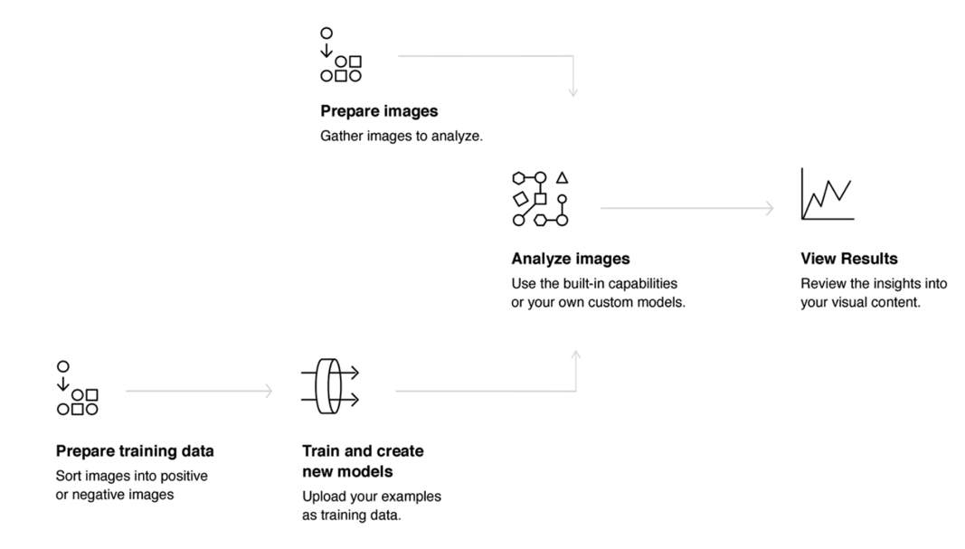
IBM Watson: the Visual Recognition example
A set of available built-in models provides highly accurate results without training:
General model: Default classification from thousands of classes.
Face model: Facial analysis with age and gender.
Explicit model (Beta): Whether an image is inappropriate for general use.
Food model (Beta): Specifically for images of food items.
Text model (Private beta): Text extraction from natural scene images.
You can also train custom models to create specialized classes.
How To use the service:
Notes:
Find meaning in visual content! Analyze images for scenes, objects, faces, and other content. Choose a default model off the shelf, or create your own custom classifier. Develop smart applications that analyze the visual content of images or video frames to understand what is happening in a scene.
Features:
General Model
Generate class keywords that describe the image. Use your own images, or extract relevant image URLs from publicly accessible webpages for analysis.
Food Model (Public Beta)
Utilize a specialized vocabulary of over 2000 foods to identify meals, food items, and dishes with enhanced accuracy.
Custom Model
Create custom, unique visual classifiers. Use the service to recognize custom visual concepts that are not available with general model.
Explicit Model (Public Beta)
Assess whether an image contains objectionable or adult content that may be unsuitable for general audiences.
Face Model
Detect human faces in the image. This service also provides a general indication of age range and gender of faces.
Text Model (Private Beta*)
Automatically detect and extract recognized words within natural scene images. *Private Beta is an invite only program. Customers must have a Standard Plan to be eligible to use Private Beta features. To request access to the Text Model Private Beta, please contact shantenu.agarwal@us.ibm.com
Use cases
The Visual Recognition service can be used for diverse applications and industries, such as:
Manufacturing: Use images from a manufacturing setting to make sure products are being positioned correctly on an assembly line
Visual auditing: Look for visual compliance or deterioration in a fleet of trucks, planes, or windmills out in the field, train custom models to understand what defects look like
Insurance: Rapidly process claims by using images to classify claims into different categories
Social listening: Use images from your product line or your logo to track buzz about your company on social media
Social commerce: Use an image of a plated dish to find out which restaurant serves it and find reviews, use a travel photo to find vacation suggestions based on similar experiences
Retail: Take a photo of a favorite outfit to find stores with those clothes in stock or on sale, use a travel image to find retail suggestions in that area
Education: Create image-based applications to educate about taxonomies

Slide 30
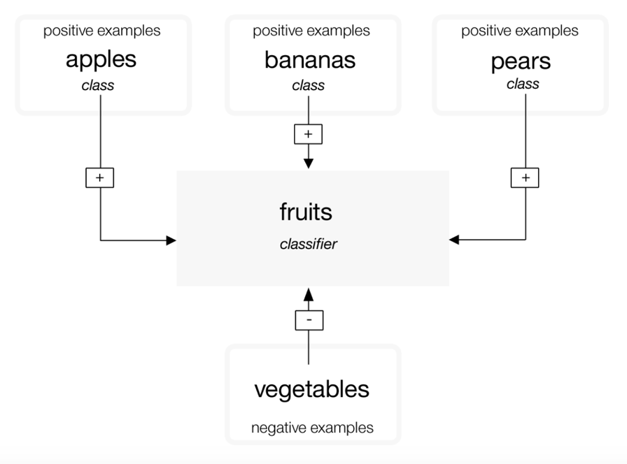
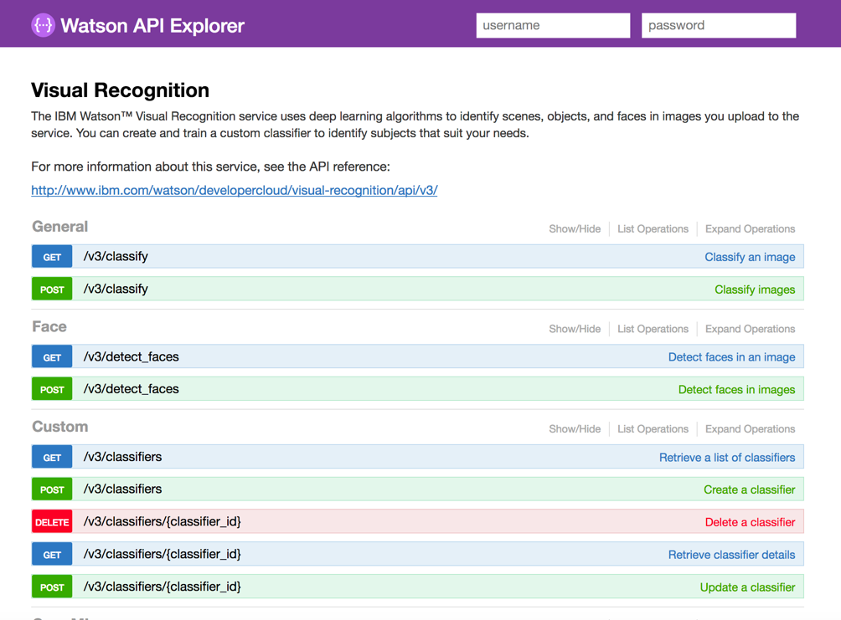
IBM Watson: the Visual Recognition example
Notes:
General classifier categories
The General classifier returns classes from thousands of possible tags organized into categories and subcategories. The following list shows the top-level categories:
Animals (including birds, reptiles, amphibians, etc.)
Person and people-oriented information and activities
Food (including cooked food and beverages)
Plants (including trees, shrubs, aquatic plants, vegetables)
Sports
Nature (including many types of natural formations, geological structures)
Transportation (land, water, air)
And many more, including furnishings, fruits, musical instruments, tools, colors, gadgets, devices, instruments, weapons, buildings, structures and man-made objects, clothing and garments, and flowers, among others.
Classify response hierarchy
The /v3/classify method classifies images within a hierarchy of related classes. For example, a picture of a Beagle might be classified as "animal" as well as the related "dog" and "beagle". A positive match with the related classes, in this case "dog" and "beagle", boosts the score of the parent response. In this example, the response includes all three classes: "animal", "dog", and "beagle". The score of the parent class ("animal") is boosted because it matches the related classes ("dog" and "beagle"). The parent is also a "type_hierarchy" to show that it is a parent of the hierarchy.
Structure of the training data
A custom classifier is a group of classes that are trained against each other. This allows you to create a multi-faceted classifier that can identify highly specialized subjects, while also providing a score for each individual class.
During training, classes are created when you upload separate compressed (.zip) files of positive examples for each class. For example, to create a classifier called "fruit", you might upload a .zip file of images of pears, a .zip file of images of apples, and a .zip file of images of bananas in a single training call.
You can also provide a .zip file of negative examples in the same training call to further hone your classifier. Negative example files are not used to create a class. For the custom classifier "fruit", you might provide a .zip file with images of various vegetables.
After training completes, when the service identifies fruit in an image, it will return the classifier "fruit" as an array containing the classes "pears", "apples", and "bananas" with their respective confidence scores.
Important: The Create a classifier call requires that you provide at least two example .zip files: two positive examples files or one positive and one negative file.
Custom classifiers are accessible only to the specific service instance where they were created and cannot be shared with other IBM Cloud users who do not have access to your instance of the service.
Updating custom classifiers
You can update an existing classifier by adding new classes or by adding new images to existing classes. To update the existing classifier, use several compressed (.zip) files, including files containing positive or negative images (.jpg, or .png). You must supply at least one compressed file, with additional positive or negative examples.
Compressed files containing positive examples are used to create and update "classes" to impact all of the classes in that classifier. The prefix that you specify for each positive example parameter is used as the class name within the new classifier. The "_positive_examples" suffix is required. There is no limit on the number of positive example files you can upload in a single call.
The compressed file containing negative examples is not used to create a class within the created classifier, but does define what the updated classifier is not. Negative example files should contain images that do not depict the subject of any of the positive examples. You can only specify one negative example file in a single call.
How retraining works
If you train a classifier with three sets of positive class pictures - Apples, Bananas, and Pears - the system trains three models internally. For the Apples model, the group of pictures in "Apples" is trained as a positive example, and the group of pictures uploaded in "Bananas" and "Pears" are trained as negative examples. The system then knows that bananas and pears are not apples. The other classes are used as negative examples for the Bananas, and Pears models as well.
Next, say you want to retrain your classifier with new positive classes: YellowPears and GreenPears. In order to do this, you'll need to manually look through your old pears.zip folder, and split the images out into two new folders: YellowPears.zip and GreenPears.zip.
Important: Splitting a class definition via retraining is possible, but it calls for great care in organizing the data. You must submit the exact same image files to the new folders - no resizing or anything - that you used during the original training. For example, when creating YellowPears or GreenPears, every single yellow pear image from the original pears.zip training set should be exactly copied into the YellowPears.zip folder; otherwise, any image that is not copied exactly will be in the Pears training set, and used as a negative when YellowPears is trained.
Now, you simply retrain the system with YellowPears.zip and GreenPears.zip as positive examples. When you do this, the system recognizes the exact duplicate images in the YellowPears and GreenPears folders from the original pears.zip folder, and those images are retrained as positive examples for their new classes. The rule is that a duplicate image is kept in the positive set, if it is also found in both the negative and positive set for a class.
The end result is that the YellowPears and GreenPears classes will have Apples and Bananas as negative examples, but will not have any exact duplicate images from the Pears class as negative examples.
Size limitations
There are size limitations for training calls and data:
The service accepts a maximum of 10,000 images or 100 MB per .zip file
The service requires a minimum of 10 images per .zip file.
The service accepts a maximum of 256 MB per training call.
Minimum recommended size of an image is 32X32 pixels.
There are also size limitations when classifying images or detecting faces:
Limitations for the methods to classify images:
Maximum image size is 10 MB.
Maximum .zip file size is 100 MB with up to 20 images.
Limitations for the methods to detect faces:
Maximum image size is 10 MB.
Maximum .zip file size is 100 MB with up to 15 images.
Guidelines for good training
The following guidelines are not enforced by the API. However, the service tends to perform better when the training data adheres to them:
Make sure that your images are at least 224 x 224 pixels.
For .png images, make sure that the pixel depth is set to at least 24 bits per pixel:
To check the depth on MacOS, run the file command. 24-bit depth is displayed as 8-bit/color.
To check on Windows, right-click the file and choose Properties > Details. Look for Bit depth.
Include at least 50 positive images per class before you assess your training results.
Assuming similar quality and content for your training data, more training images generally provide more accurate results than fewer images.
150 - 200 images per .zip file provides the best balance between processing time and accuracy. More than 200 images increases the time and the accuracy, but with diminishing returns for the amount of time it takes.
The benefits of training a classifier on more images plateaus at around 5000 images. Although you can train on more than 5000 images, that number might not significantly increase accuracy, and increases processing time.
Include a negative class to help improve your results.
Include approximately the same number of negative images as positive ones. An unequal number of images might reduce the quality of the trained classifier.
Make sure that the backgrounds in your training images are comparable to what you expect to classify. The accuracy of your classifier can be affected by the kinds of images you provide to train it.
For example, if you are training the "tiger" classifier, your classifier might be less accurate if you train only on images of tigers in a zoo that are taken by a mobile phone but analyze images that taken in the wild taken by professional photographers.
Make sure that the subject matter of the classifier is at least 1/3 of the image's overall size.
For more information about training, see Best practices for custom classifiers .
Guidelines for high volume classifying
Maximize efficiency and performance of the service in the following ways when you submit many images:
Crop or resize your images to 224 x 224 pixels. The service is currently optimized for this size although it might change.
Crop the image if it has an aspect ratio greater than 2:1 or under 1:2.
Consider cropping the image into multiple square images, or include only the center of the image, depending on what is most important to your use.
Submit up to 20 images in a single .zip file. You don't need to use any compression because JPEG and PNG images are compressed files.
Use the classifier_ids parameter to specify only the classifiers that you want to use.
Although the service reads EXIF tags and rotates images, for the best throughput, send images that don't need to be rotated by the service (the EXIF Orientation tag is set to 1).
Custom classifier scores
The /classify method produces a score between 0.0 and 1.0 for each image for each class. This section delves into the meaning of those scores for custom classifiers (as opposed to the General classifier).
Background reading
The service performs statistical classification.
You can measure statistical classifiers in several ways.
How to use the scores
Think about possible actions to be taken in response to a classification. Specifically, analyze how you will use "true" or "false" positive or negative conditions. These conditions are described in the Background Reading.
This cost-benefit balance is crucial to deciding what to do with each class score, and only someone who understands the final application can determine it. The score value needed for the application to take some action is called the "decision threshold." The service does not compute this for you.
Custom classifiers use binary "one versus the rest" models to train each class against the other classes. The system assumes that two classes within a classifier cannot occur at the same time, so you should create separate classifiers to test for classes that can exist together, like blue and sky. Alternatively, you could create a distinct classifier for cases where both classes exist at the same time and test for a class like blueSky.
Example
Imagine that you are monitoring an assigned parking space with a webcam. You train a custom classifier to recognize whether your car is in the spot, some other car is in the spot, the spot is empty, or the camera has been blocked. You collect training examples for each of these cases and train a custom classifier with four classes. Your application classifies images from the webcam to report the status of the spot, and the system notifies you with a message if the status is unexpected. Each time the service classifies the image from the camera, it produces four scores: myCar, unknownCar, emptySpot, and blockedCamera.
The first action to consider is whether to send a notification.
Suppose you park in your spot and have the service start classifying the images. You see the myCar score computed as 0.8 on average over a few hours, while the unknownCar score hovers around 0.3, emptySpot is around 0.15 and blockedCamera is around 0.1. Given this data, you write your code to notify you if the myCar score is less than 0.75, or if one of the others is greater than 0.6. During the day, you get about one false alarm every three hours when people walk by and obscure the car. The system sends you the photo along with the notice, so you can see it's nothing to worry about. That seems fine, but then at night those false alarms every three hours get very annoying! Your preferences for day versus night notification reflect the higher cost of a false alarm at night time for your application.
So, the notification logic and threshold will probably vary, depending on the perceived risk of car theft, the accuracy of your classifiers, and the amount of annoyance caused by a false alarm.
Similarly, as a person, you may face the same trade off. If the system notifies you that the camera has been blocked, the accompanying image will likely simply be all black or gray. Do you go to check on the car in person or ignore it? Again, this depends on your other priorities and the perceived risks.
Questions
What do the scores mean?
The scores are comparable indicators, with a range from 0.0 to 1.0. You can compare the scores of two custom classes (from the same or different classifiers) on the same or different images, and the higher one should be more likely to appear in the image than the lower one. However, they may both be present. It is best to pick a decision threshold for each class individually.
The scores for custom classifiers are not comparable to the scores returned by the General classifier (which has classifier_id: "default")
The service attempts to normalize the score output so that 0.5 is a good decision threshold. By default, scores below 0.5 are not reported in the results of /classify. You can override this behavior by setting the threshold parameter of the /classify method. This normalization is only computed on the training data, so with new data or different application contexts, you might find that a different threshold works better.
The scores are unitless and are neither percentages nor probabilities. (They do not add up to 100% or 1.0).
Why do I get scores between 0.5 and 0.6 for images that I would expect to return a high score, near 1.0?
You might get lower scores if there is a significant amount of similarity between your classes, so that in the feature space your examples are not in distinct clusters, and the scores reflect this closeness to the best boundary between positives and negatives that the system could learn.
How can I evaluate the accuracy of a custom classifier for my use case?
You can do this in multiple ways, one of which is the following:
Assemble a set of labeled images "L" that was not used in training the classifier.
Split L into two sets, V and T - validation and testing.
Run V through your classifier and pick a score threshold "R" which optimizes the correctness metric you value, such as top-5 precision, across all of V.
From T, select a random subset "Q" and classify it using your classifier and "R". Compute the probability of a correct classification on Q. That's one experiment.
Repeat step 4 with a different subset Q from T, then compute the average % correct across all experiments.

Slide 31
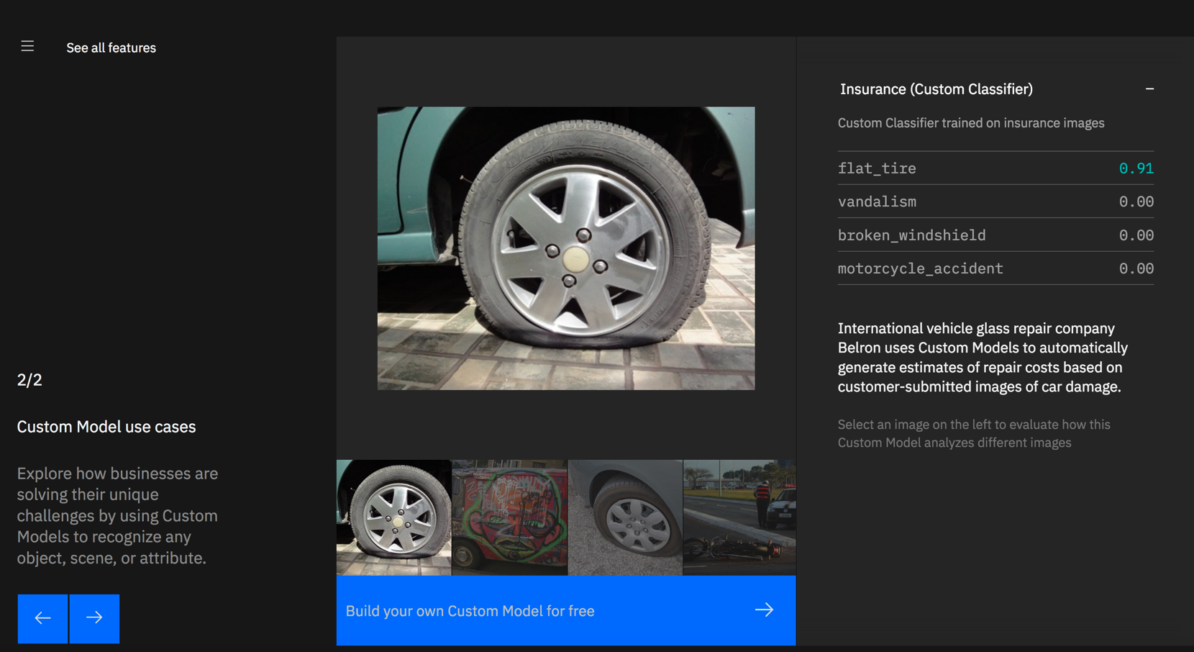
IBM Watson: the Visual Recognition example

Slide 32
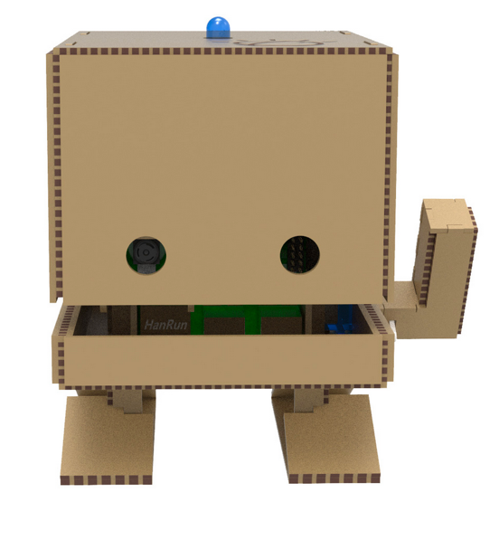
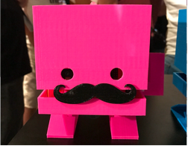
Demo: TJBot meeting the human: TJBot meets the Human #IBMCloud #Watson #BOT
IBM Watson Maker Kits are a collection of DIY open source templates to connect to Watson services in a fun way. TJBot is the first maker kit in the collection and was created as an experiment to find the best practices in the design and implementation of cognitive objects.
Node-RED installed on the Raspberry Pi
Watson services on IBM Cloud

Slide 33
Contribute to TJBot
TJBot is open source and we’d love to see what you can make with it.
You will find many recipes online an can also create your own !
http://www.instructables.com/member/TJBot/instructables/
https://github.com/ibmtjbot/tjbot
https://ibmtjbot.github.io/

Slide 34
A Toolkit for developers to get started with Watson today
Tech talks, Open source, Tutorials …
ibm.com/developerworks
developer.ibm.com/code/
medium.com/ibm-watson
ibm.com/watson/
console.bluemix.net/docs
TJBot
https://ibmtjbot.github.io/
https://github.com/binnes/tobyjnr/wiki
Events
developer.ibm.com/code/community/events

Slide 35
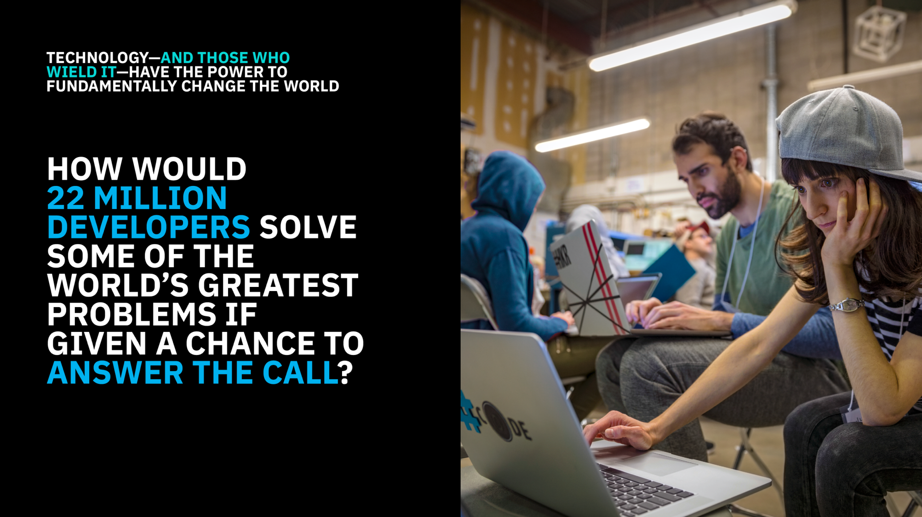
Notes:
The 2018 Call for Code Global Challenge is a competition that asks developers to outthink natural disasters and build solutions that significantly improve the current state of natural disaster preparedness in order to reduce the disruptive impact on human lives, health, and wellbeing. It is the first event run by the Call for Code Global Initiative. The prize structure is intended to act as an incentive for teams to build high-quality, lasting solutions that can be deployed in the areas of greatest need and that benefits all parties.

Slide 36
Notes:
The Call for Code Global Initiative is a rallying cry to developers to use their skills and mastery of the latest technologies to drive positive and long-lasting change across the world with their code.
For 2018, the Call for Code Global Challenge asks developers to create solutions that significantly improve preparedness for natural disasters and relief when they hit.
One team will win the first annual Call for Code Global Prize, supported by the United Nations Human Rights Office and the American Red Cross’ International team.
The winner will also earn several other awards that foster adoption of their application as an open source project (through the The Linux Foundation), scale its impact, and accelerate deployment in areas of greatest need.
Winners will be announced at the Call for Code Global Prize Event and Concert, which will benefit UN Human Rights and the American Red Cross, and be held on October 13th, the United Nations International Day for Disaster Reduction.

Slide 37
https://callforcode.org/
Notes:
During the period from May to August there are satellite public hackathons hosted by AngelHack in cities throughout the world. There are also events hosted at enterprises, startups, and universities. Each of these events will have a narrower scope of disaster preparedness tailored to the particular audience. Those events may have their own judging and prizes and should be considered a ‘feeder’ event into the main challenge, allowing you to kick-start your project with dedicated help in the short term, for solutions to be continually built in the long term.

Slide 38
Thank you !

Slide 39
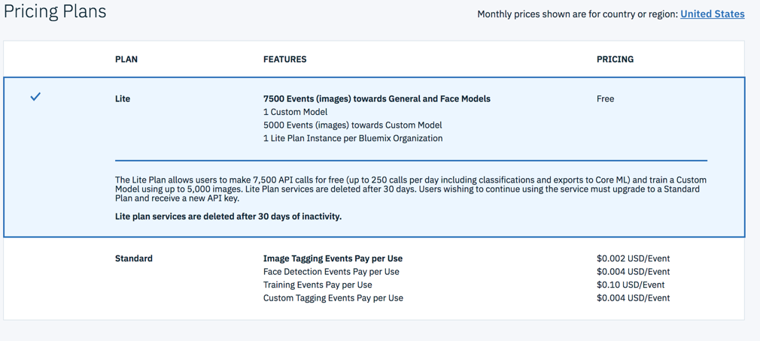
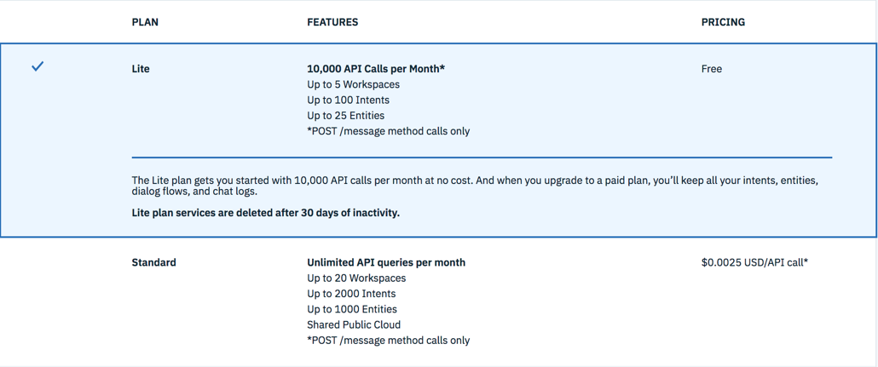
Pricing Plans examples
Visual Recognition:
Watson Assistant:

