Slide 1
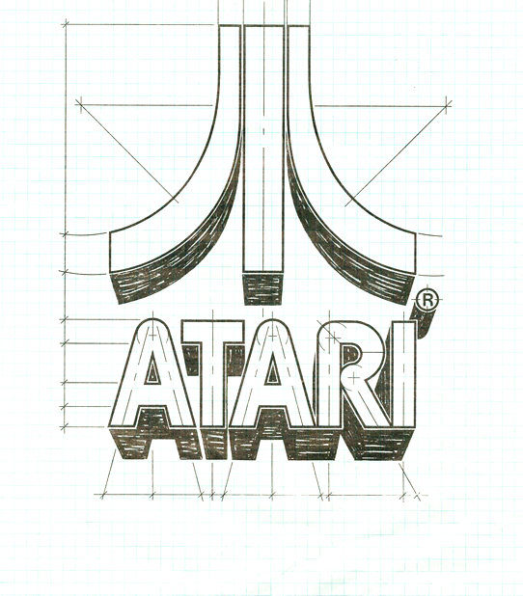
ATARI ST
History of The OS

Slide 2
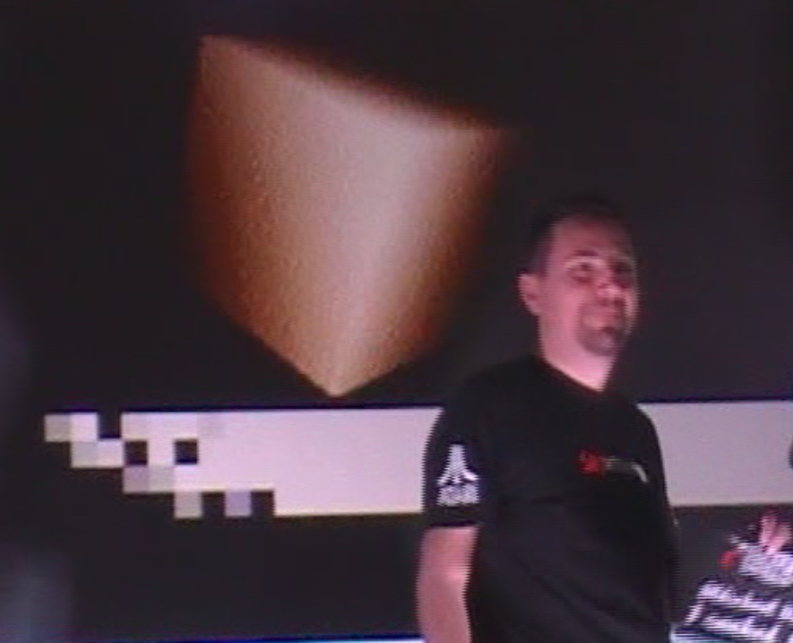
Meetup #2 – Histoire d’O(S) du CP/M à aujourd’hui
Frédéric Sagez
Vincent Rivière
September 2018

Slide 3
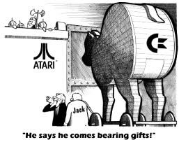
A little history of the ATARI ST
Jack Tramiel - the ousted founder of Commodore - secured funding to buy Atari’s consumer division from Warner and acquired it in July 1984 with the intent of producing a new computer. Many engineers and executives from Commodore followed Tramiel to the new Atari Corporation. In 1985 Atari Corporation introduced its new 16-bit computer system called the 520ST, the successor to the Atari 8-bit family computers at the Consumer Electronics Show in January 1985.
"ST" means Sixteen-Thirtytwo, because of the MC68000 Motorola CPU has 16-bit data bus and 32-bit internals.
Atari licensed GEM from Digital Research which was also used on some PCs and the Atari ST was the first personal computer with a full color graphical user interface.
Atari ST computers run GEM on top of the TOS much as early versions of Windows ran on top of MS-DOS. Atari developed TOS as a fast, DOS-like environment with a hierarchical file system.
Notes:
Note : the Atari ST arrived in June 1985, the Amiga 1000 in July 1985...

Slide 4
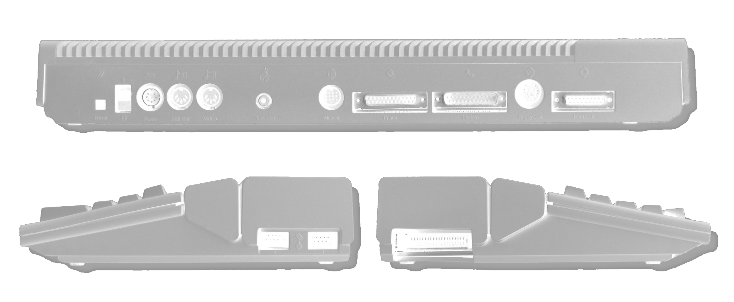
Hardware Specifications
PROCESSOR | Motorola 68000 16/32bit @ 8 MHz. 16-bit data bus/32-bit internal/24-bit address bus
COPROCESSORS | MFP 68901 for interrupt handling, Shifter for the video, GLUE and MMU for the memory, YM-2149 for the sound
RAM | 512kb (1mb for the 1040ST models)
SOUND | Yamaha YM2149F with 3 voices square wave plus 1 voice white noise mono Programmable Sound Generator
DISK DRIVE | Single-sided 3½ inch floppy disk drive with 360kb of capacity 1040ST had double-sided drives which had a capacity of 720kb
DISPLAY | 60 Hz NTSC, 50 Hz PAL, 71.2 Hz monochrome
RESOLUTION | Low Resolution - 320×200 (16 colors) with a palette of 512 colors Medium resolution - 640×200 (4 colors) High resolution – Mono - 640×400
PORTS | TV out (on ST-M and ST-FM models, NTSC or PAL standard RF modulated) RS-232 serial, Centronics parallel (printer) Monitor (RGB or Composite Video colour and mono, 13-pin DIN) Extra Disk drive port (15-pin DIN) DMA port (ACSI port, Atari Computer System Interface) for hard disks and Atari Laser Printer Joystick and Mouse ports (Atari standard) MIDI "IN" and "OUT/THRU"

Slide 5
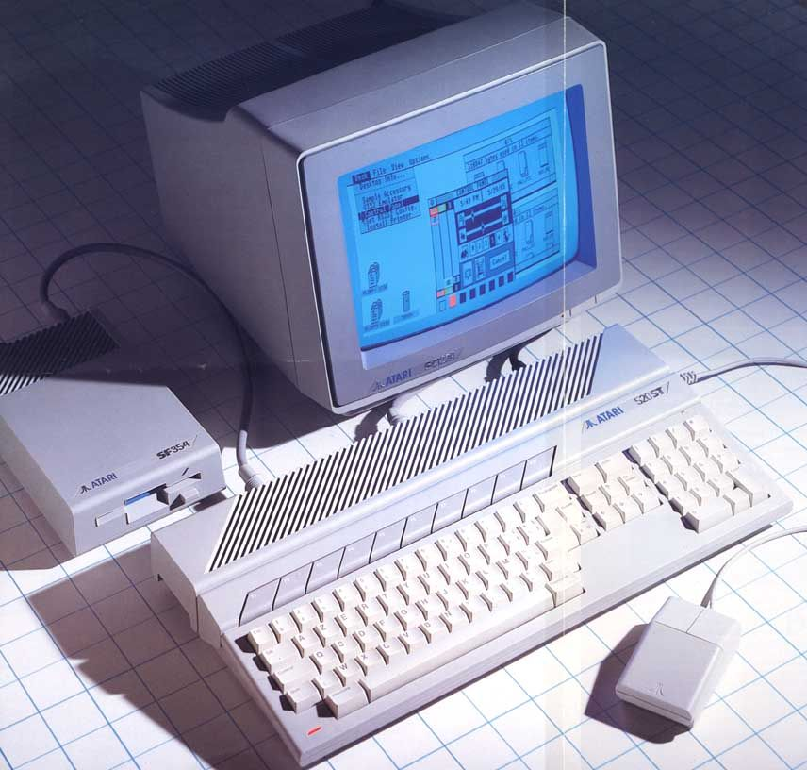
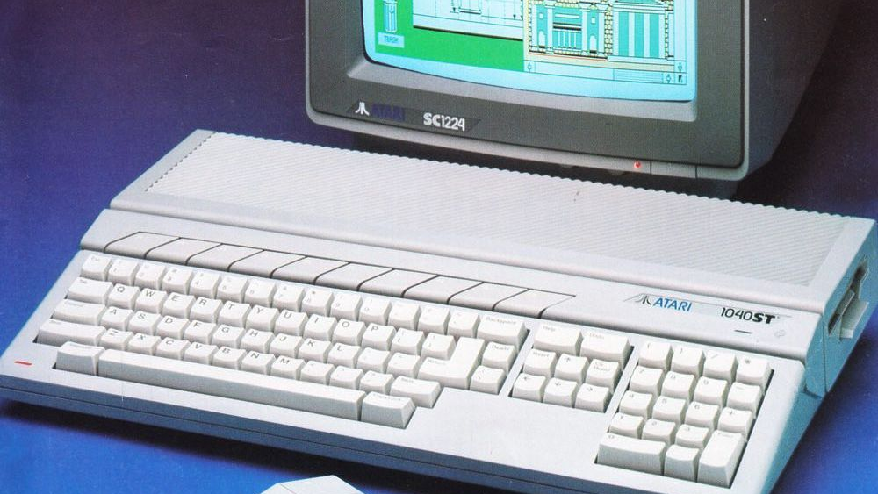
The Operating System
The TOS is stored in onboard ROM chips, though early versions of the Atari ST came with TOS on floppy disks

Slide 6
About The Operating System
The operating system in the Atari ST is called TOS which simply means "The Operating System“ - and not the “Tramiel Operating System” ☺
The Atari ST has an extremely complex operating system consisting of several groups of routines that comprise several different levels of interaction with the machine
It combines the GEM GUI and the underlying GEMDOS, a DOS-like operating system by Digital Research which originally developed GEM as a graphic layer on top of MS-DOS
Because it’s stored on ROM chips it boots up instantly!

Slide 7
TOS - The Operating System
The ST's OS can be divided into three large groups of routines:
BIOS, XBIOS and Line A libraries. These libraries control machine dependent functions (like controlling the peripherals) and basic I/O.
GEM (Graphics Environment Manager) contains two libraries, the AES and VDI routines. GEM is responsible for the windowing environment and the desktop that makes using the ST more intuitive. The AES is concerned mostly with windows and dialogs, things that the user interacts with. The VDI routines handle complex text display and high level graphics manipulations.
GEMDOS (GEM Disk Operating System) are the machine independent routines for handling files and tasks (programs) and doing "high" level I/O.
Both TOS and GEM are stored entirely in the system's ROM

Slide 8
TOS - The Operating System
GEMDOS: GEM Disk Operating System
GEM: Graphics Environment Manager
EXTENSION
GDOS: Graphics Device Operating System
AES: Application Environment Services
MetaDos: block-oriented devices
VDI: Virtual Device Interface
BIOS: Basic Input/Output System
XBIOS: Extended BIOS (Peripherical management)
LINE-A: Low-level high-speed graphics calls
Devices

Slide 9
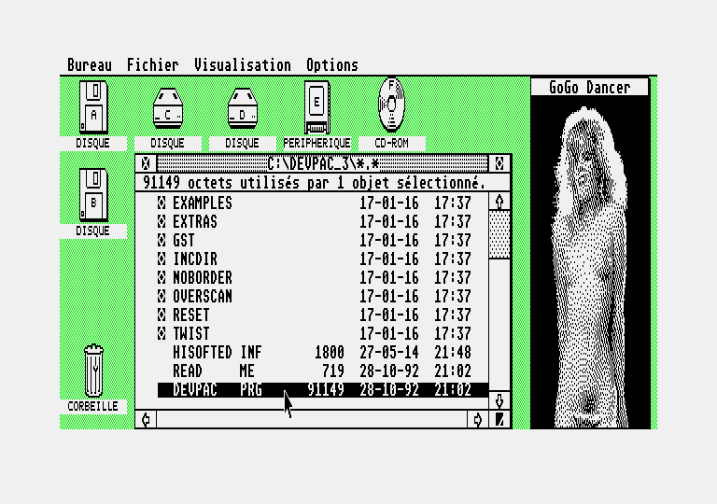
GEM, a little green Desktop

Slide 10
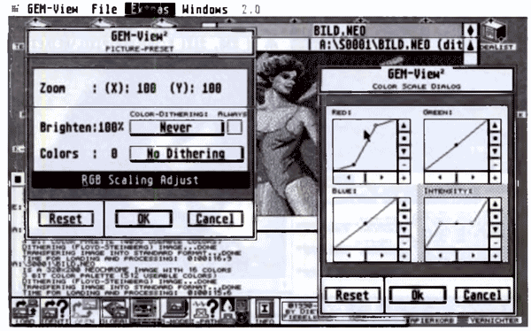
GEM - Graphics Environment Manager
The Graphics Environment Manager is a machine independent with set of routines that enable the programmer to use windows, dialogs, the mouse, buttons, and sliders to interface with an end user.
GEM also allows you to present complex graphics and output them to a number of different devices. It is built so that these features can be defined, accessed, and used with a relatively small number of routines. It also allows limited multitasking through desk accessories.
GEMView
Notes:
GEM vous permet également de présenter des graphiques complexes et de les afficher sur différents périphériques.
Il est conçu pour que ces fonctionnalités puissent être définies, consultées et utilisées avec un nombre relativement restreint de routines.
Il permet également le multitâche limité grâce aux accessoires de bureau.

Slide 11
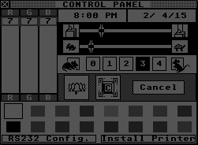
GEM - Graphics Environment Manager
The desktop uses icons to represent devices and files and has windows and dialog boxes. The standard desktop has a trashcan and two floppy disk icons. On the top part is a drop down menu. It changes its contents depending on the application (much like on a Macintosh), though applications are not required to even use the menu in which case it is removed.
TOS can execute a variety of different filetypes identified by their extensions:
.ACC - Desktop accessory (loaded automatically)
.PRG and .APP - Executable program (often GEM programs)
.TOS - Programs that only uses GEMDOS and not the GEM system to work.
.TTP - TOS Takes Parameters. Opens up a dialog box in which you can add arguments for the program.
If the floppy is inserted into the drive when the computer boots, it will bypass the GEM desktop and boot the program contained in an AUTO folder. This is used by many demos and most games ☺

Slide 12
Atari ST - Ready to use?

Slide 13
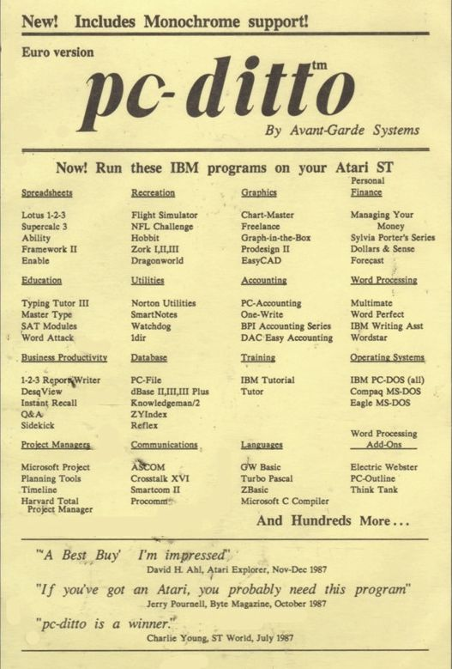
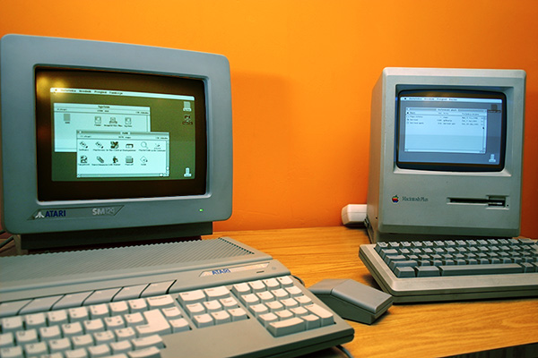
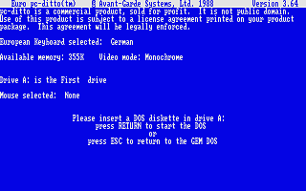
System compliance and emulations
MAC
Soft : Aladin
Hardware : Spectre GCR
Atari STF surnamed « Jackintosh »
IBM PC
Soft : PC DITTO
Hardware : SuperCharger
GEMDOS which makes easy the transition from the PC to the ST and is compatible with the DOS calls of the PC (int 21h)
Notes:
« Jackinstosh » - System 6.0.3

Slide 14
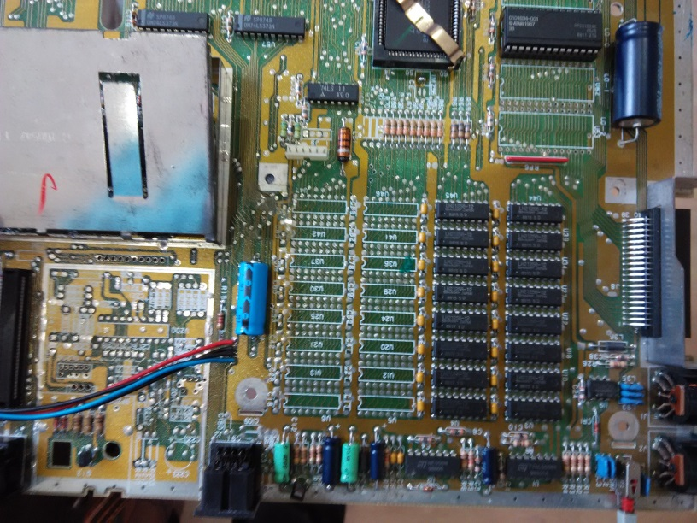
Evolution of the Atari ST OS
MUSHROOM
OLD TOS
MEGA TOS
RAINBOW TOS
ROM TOS
BLITTER
KAOS
STE TOS
1985
1990
Version | Name | Date | Support | GEMDOS | AES | Model
1.00 | Mushroom | 20.06.1985 | RAM | 0.13 | 1.01 | ST
1.00 | Old TOS | 06.02.1986 | ROM | 0.13 | 1.20 | ST/STF
1.02 | Blitter | 22.04.1987 | ROM | 0.13 | 1.40 | MEGA/STF
1.04 | Rainbow TOS | 22.02.1989 | ROM | 0.15 | 1.40 | MEGA/STF/STACY
1.06 | STE TOS | 19.06.1989 | ROM | 0.15 | 1.40 | STE
1.62 | STE TOS | 11.01.1990 | ROM | 0.17 | 1.40 | STE

Slide 15
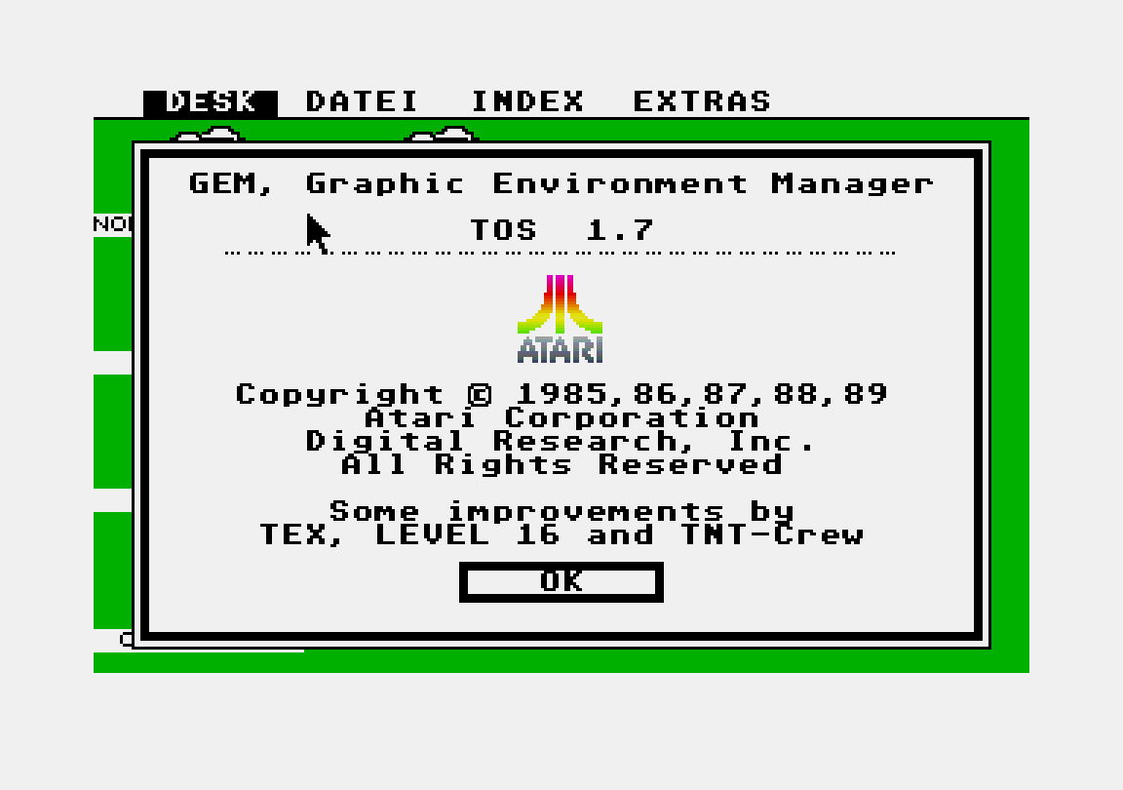
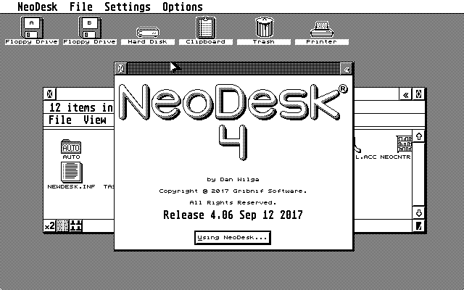
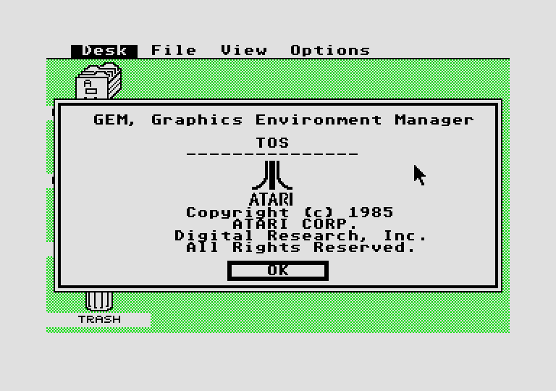
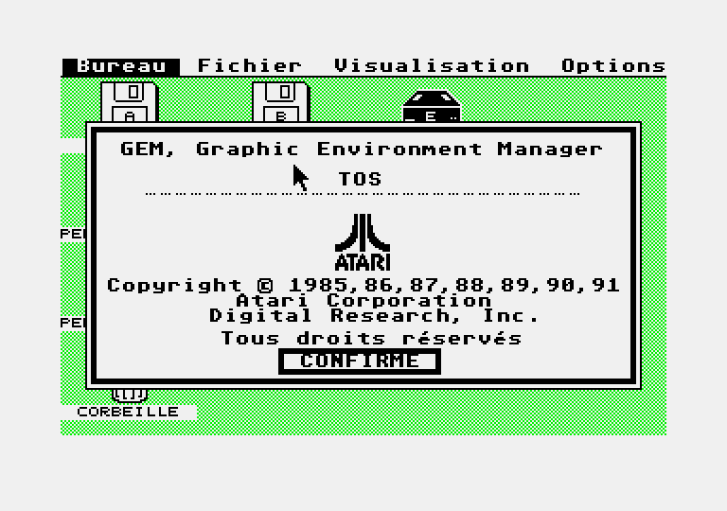
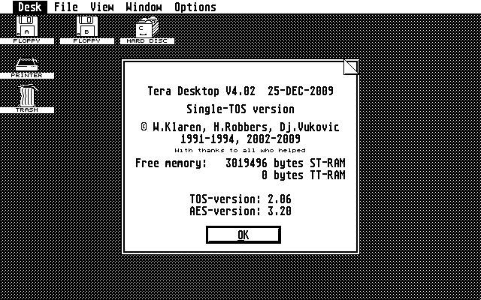
Quizz: which version I need?
Notes:
Questions :
Qui est la première et la dernière version du TOS pour le ST ?
Ceux qui ne sont pas de vrai TOS ?
Lequel est un TOS non officiel ?

Slide 16
TOS – Pros and Cons
Stable and not memory hungry
The System resides in ROM and It doesn't utilize the system RAM
It doesn't support multitasking
Memory can be upgraded to 12mb
The system switches the CPU time between those seven tasks if they interact with the GEM (parallel architecture)
The System and the keyboard supports 12 languages
It doesn't support big logical drives (need to make several partitions)
Atari TOS is based on GEMDOS which uses a modified FAT12 on floppies (360ko to 900ko) or FAT16 on hard disks file system (partition is about 512 MB)
GEMDOS disc file systems can be read on PC using DOS or Windows
Notes:
You can have up to 16 logical drives, 14 of them can be hard disk partitions. Each one is limited to 32766 data clusters, up to 16384 bytes each. It means, that the maximum capacity of a partition is about 512 MB.
// = cela signifie, en gros que les différents coprocesseurs agissent parallèlement les uns aux autres.
Ils ont de ce fait des rapports directs et peuvent communiquer sans passer par le chef, le 68000 !
Langues: United Kingdom,United States,Finland,Norway / Denmark,Sweden,Japan,Germany,French Canada,France,Italy,Spain

Slide 17
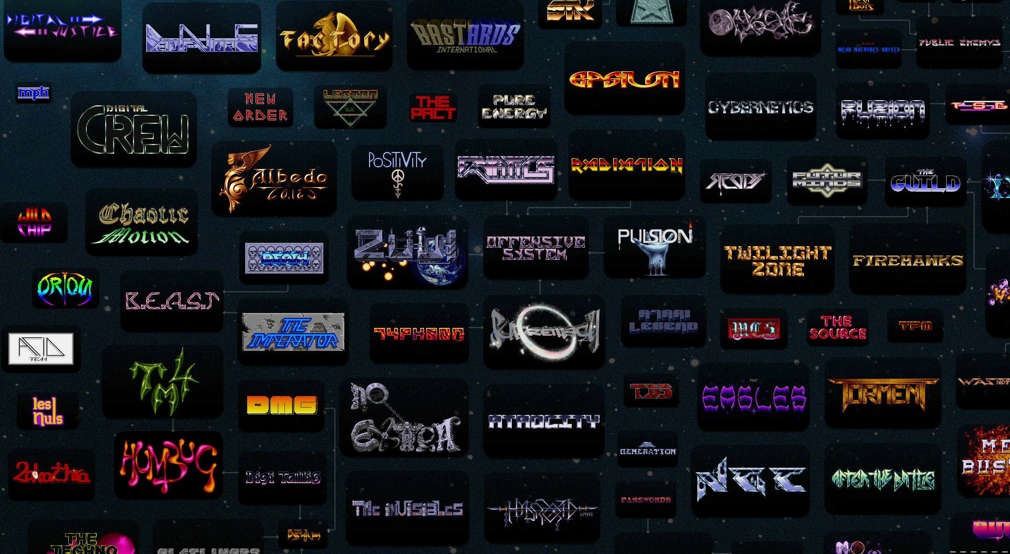
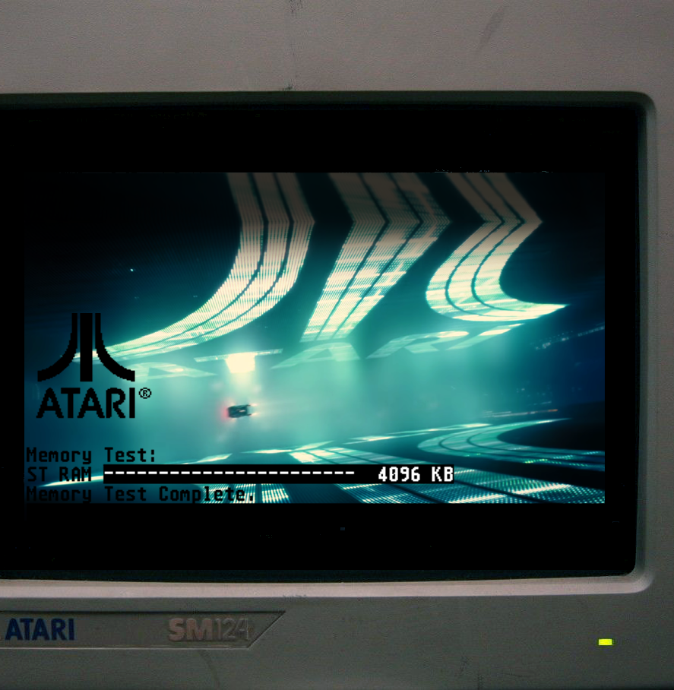
TOS – what future?
Notes:
Assessments after the ATARI ST and Atari STF

Slide 18
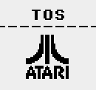
Atari TOS versions
Official TOS versions for Atari computers:
1985-1990: TOS 1.x (ST / STf / Mega ST / STe)
1990-1991: TOS 2.x (Mega STe)
1990-1991: TOS 3.x (TT)
1992-1993: TOS 4.x (Falcon)
Always fully contained in ROM
New versions mainly add support for new hardware
A few minor evolutions (XBIOS, AES, Desktop)
Notes:
Assessments after the ATARI ST and Atari STF

Slide 19
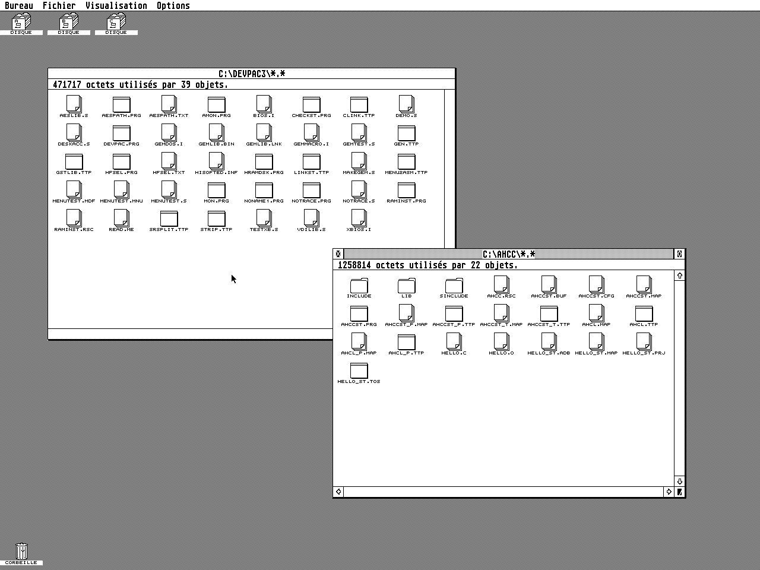
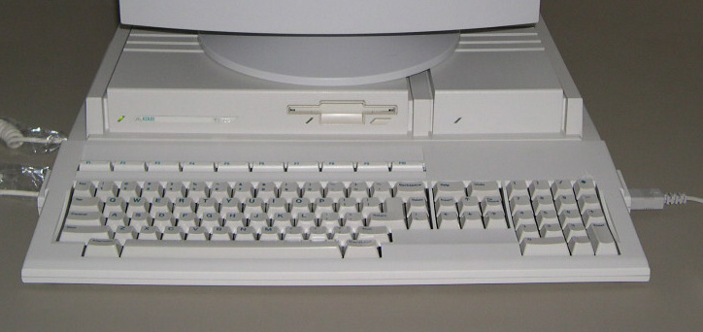
Atari TT (1990), TOS 3.06
Up to 1280x960 in monochrome
Also supports 640x480 16 colors 320x480 256 colors

Slide 20
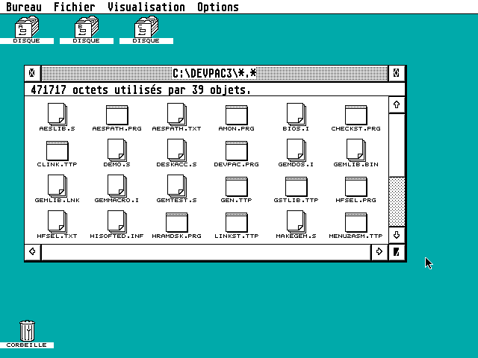
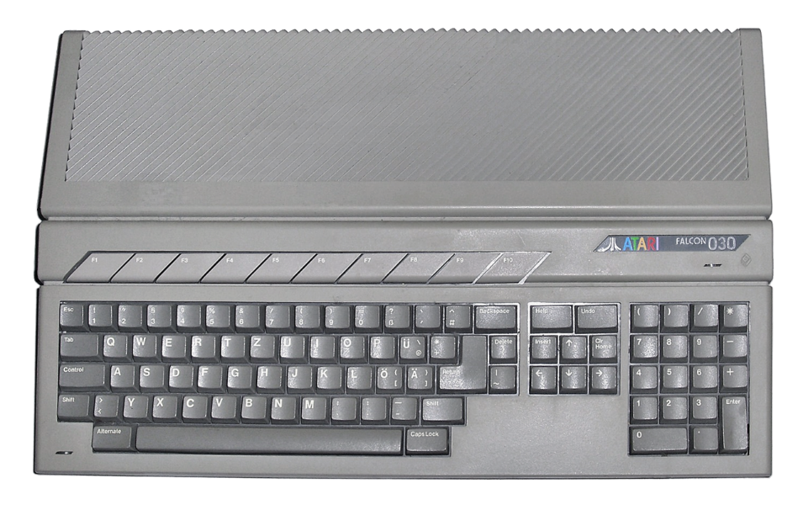
Atari Falcon 030 (1992), TOS 4.04
640x480, VGA
2, 4, 16 or 256 colors
Also supports 16-bit High-Color in 320x240

Slide 21
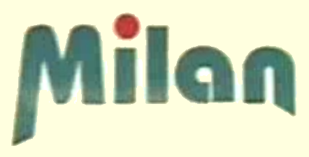
TOS for Atari clones
Medusa Computer Systems
T40 (1995), Hades 040/060 (1996)
Modified TOS 3.06
MILAN-Computersystems GbR
Milan 040/060 (1998)
Modified TOS 4.04 (4.05 – 4.08)
Those companies got contracts with Atari to redistribute modified TOS

Slide 22
Patched TOS binaries
CT60 TOS by Didier Méquignon (2001-2011) Falcon TOS 4.04 patched to support CT60/CT63/CTPCI accelerator boards: 68060 CPU, FastRAM, extension port. Even more modified as FireTOS for the FireBee and its ColdFire processor.
TOS 1.04 & 1.62 updates by PP (2018) Bugfixes, improved FAT support for bigger partitions, virtual floppy support, and much more.

Slide 23
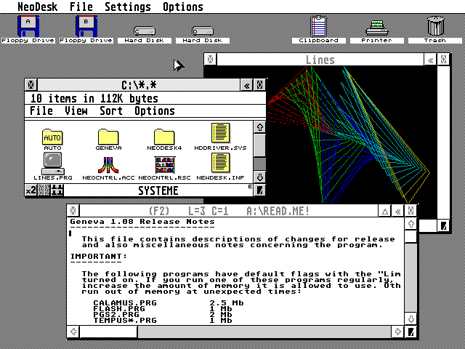
Alternate OS: Geneva (1993) by Gribnif Software
Cooperative multitasking
Best used with NeoDesk desktop
Open-sourced in 2018

Slide 24
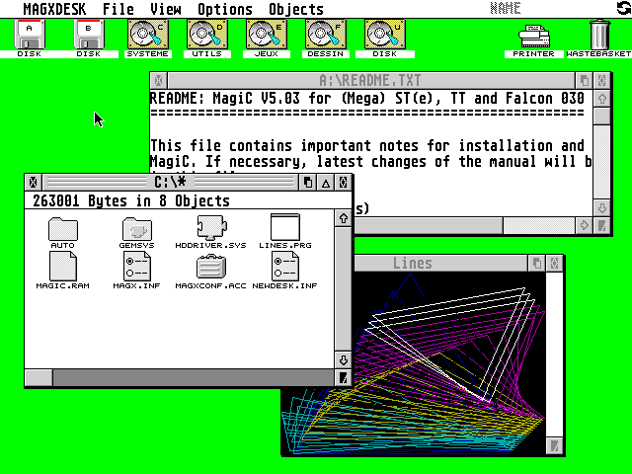
Alternate OS: MagiC (1992) by A. Kromke, S. & W. Behne
Preemptive multitasking
New desktop: MAGXDESK
Also available on Mac, PC
Successor AtariX open-sourced in 2018

Slide 25
But let’s go back in time for the real revolution…

Slide 26
MiNT: MiNT is Not TOS (1990) by Eric R. Smith
Preemptive multitasking kernel
Works on top of TOS
Device drivers support
Alternate file system support (MINIX, ext2, FAT32)
Long File Names support (VFAT)
Extends the TOS API (GEMDOS) with UNIX-like features
Includes TCP/IP stack

Slide 27
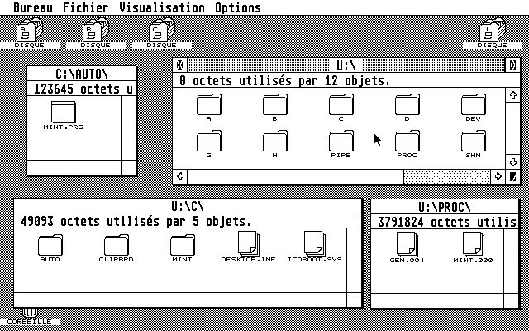
MiNT: Seen from ROM Desktop
Unified U: virtual drive as single root
Contains links to partitions
UNIX-like pipe, proc, shm directories

Slide 28
MiNTLib: C standard library
Support for major compilers: Pure C, C68, GCC...
Provide POSIX API on top of TOS/MiNT
Translate POSIX calls at runtime
To MiNT system calls if available
Otherwise to TOS system calls
Binaries can automatically take advantage of MiNT features at runtime, when available.
Most GNU / Linux software can be built out of the box

Slide 29
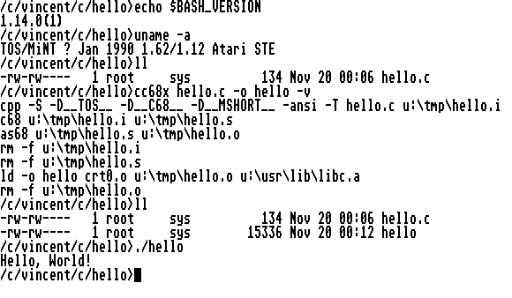
MiNT + MiNTLib: POSIX environment
Translation of paths between DOS-like and UNIX-like
Example: /tmp = u:\tmp
Old MiNT setup on ST (1995)

Slide 30
Atari MultiTOS (1992)
Atari hired Eric R. Smith
MultiTOS = MiNT kernel + multitasking AES (user interface) + multitasking desktop
Nice but a bit slow, needs RAM
Mainly for high-end TT / Falcon or clones
MiNT kernel was renamed to “MiNT is Now TOS”

Slide 31
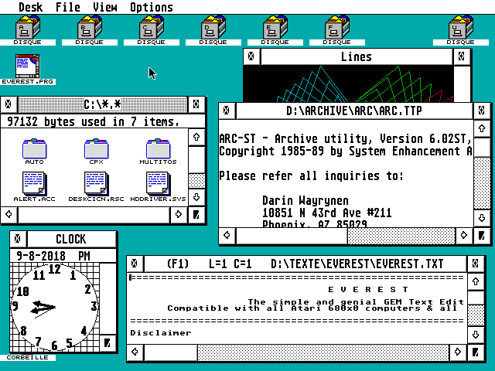
Atari MultiTOS (1992)
MiNT kernel behind the scenes
Multitasking AES and Desktop

Slide 32
FreeMiNT (2000…)
Continuation of MiNT kernel, as Free Software
Put into CVS in 2000, then Git in 2017
Actively supported by the community based around the MiNT Mailing List
Automatic builds with GitHub, Travis CI and Bintray
Shipped with XaAES graphical user interface

Slide 33
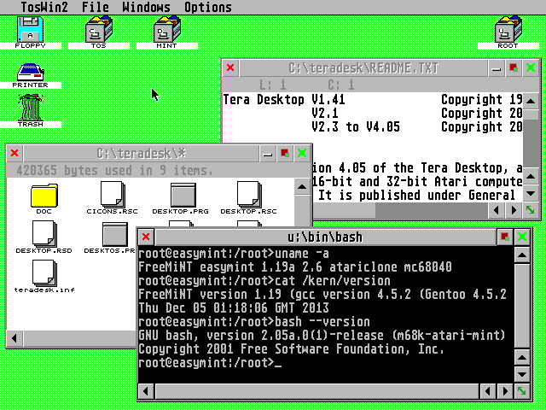
XaAES: multitasking AES for FreeMiNT
FreeMiNT kernel behind the scenes
XaAES windowed environment
Tera Desktop
All of them: Free Software

Slide 34
SpareMiNT distribution (2000~2010)
FreeMiNT kernel
GCC + MiNTLib
RPM packages (Red Hat)
Huge efforts to provide a full UNIX-like environment: many, many Free packages, mostly from GNU/Linux.
Can be installed with EasyMiNT installer

Slide 35
Everything is Free Software… except TOS ROMs?

Slide 36
EmuTOS (2001…)
New operating system compatible with Atari TOS
Implemented as Free Software, GPLv2 license
Based on open-sourced old Digital Research GEM sources
Does not contain any code from Atari company (still copyrighted)
Gaps were filled by the EmuTOS development team
Reimplementation of all layers: BIOS, GEMDOS (BDOS), VDI, AES, Desktop
Available in many variants: ROM, PRG, floppy, cartridge…
Supports all Atari computers, all 680x0 CPU, ColdFire CPU, and even non-Atari hardware

Slide 37
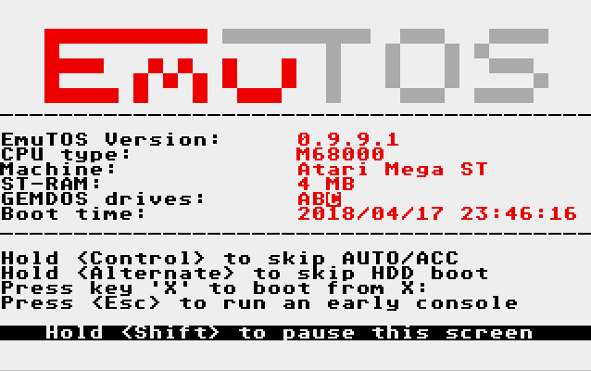
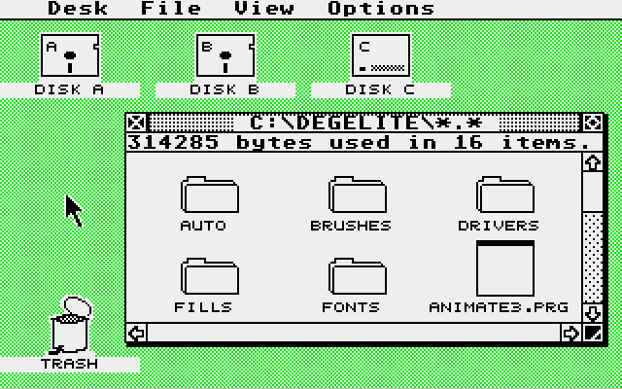
EmuTOS
All TOS layers are reimplemented as Free Software

Slide 38
Surprisingly similar, isn’t it?

Slide 39
History of GEM on PC
1984: Digital Research Inc.
1991: Novell (bought Digital Research Inc.)
1996: Caldera, Inc. (bought DR-DOS from Novell)
1998: Caldera Thin Clients, Inc. (subsidiary of Caldera, Inc.)
1999: Lineo (new name of Caldera Thin Clients, Inc.)
1999: GPL (by Caldera/Lineo)
Full history: Wikipedia Archive (including downloads): GEM Contents And also: John Elliott’s GEM pages, FreeGEM, OpenGEM

Slide 40
GEM sources
from Digital Research
+ Atari code (1985)
Freed under GPL by Caldera/Lineo (1999)
+ new GPL code
© Atari Inc. (abandonware)
Free Software actively supported

Slide 41
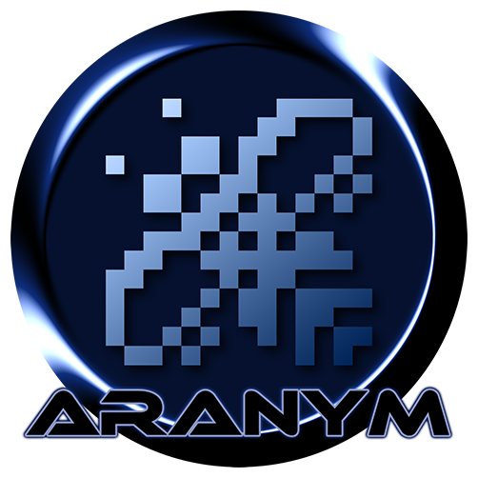
Emulators + EmuTOS + FreeMiNT
Modern platform, TOS compatible + UNIX-like
100% Free Software
Standard emulators: Hatari and Steem SSE
Extended emulator: ARAnyM
Improved block device support
Access to host filesystem
Extended video modes
Network bridge
OS support through EmuTOS, fVDI and FreeMiNT drivers

Slide 42
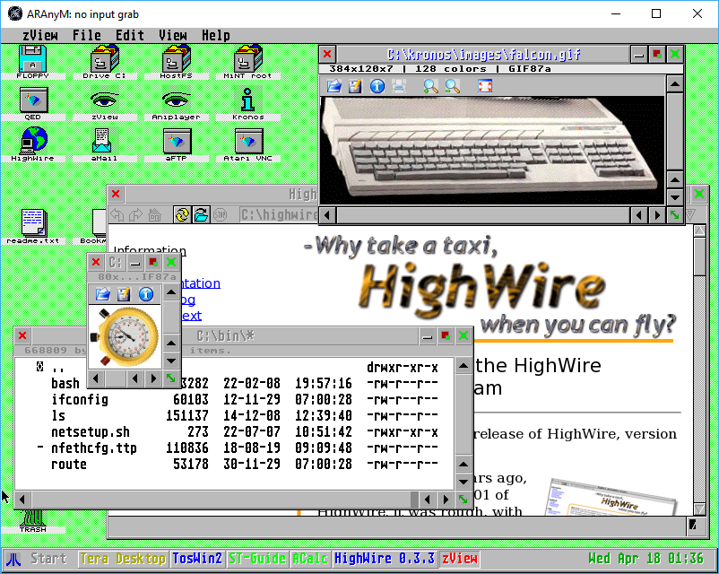
Distributions
AFROS
miniPack
VanillaMiNT
EasyAraMiNT
BeeKey (for PC) / BeePi (for Raspberry Pi)

Slide 43
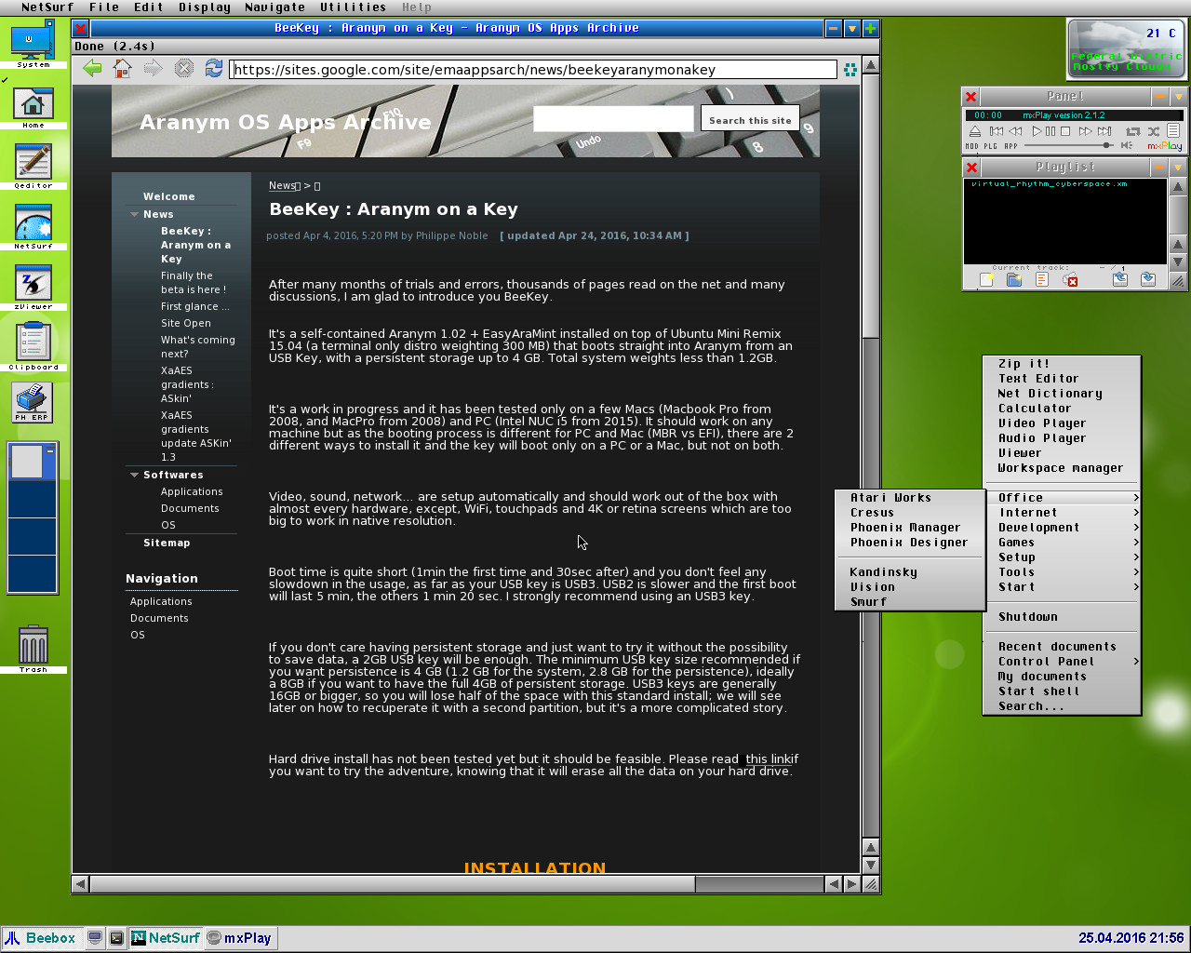
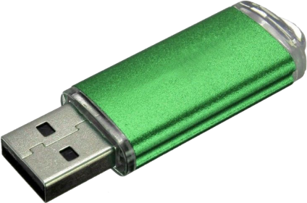
BeeKey / BeePi distribution by Philippe Noble
GNU/Linux, ARAnyM, FreeMiNT… on bootable USB key for PC, Mac, or Raspberry Pi

Slide 44
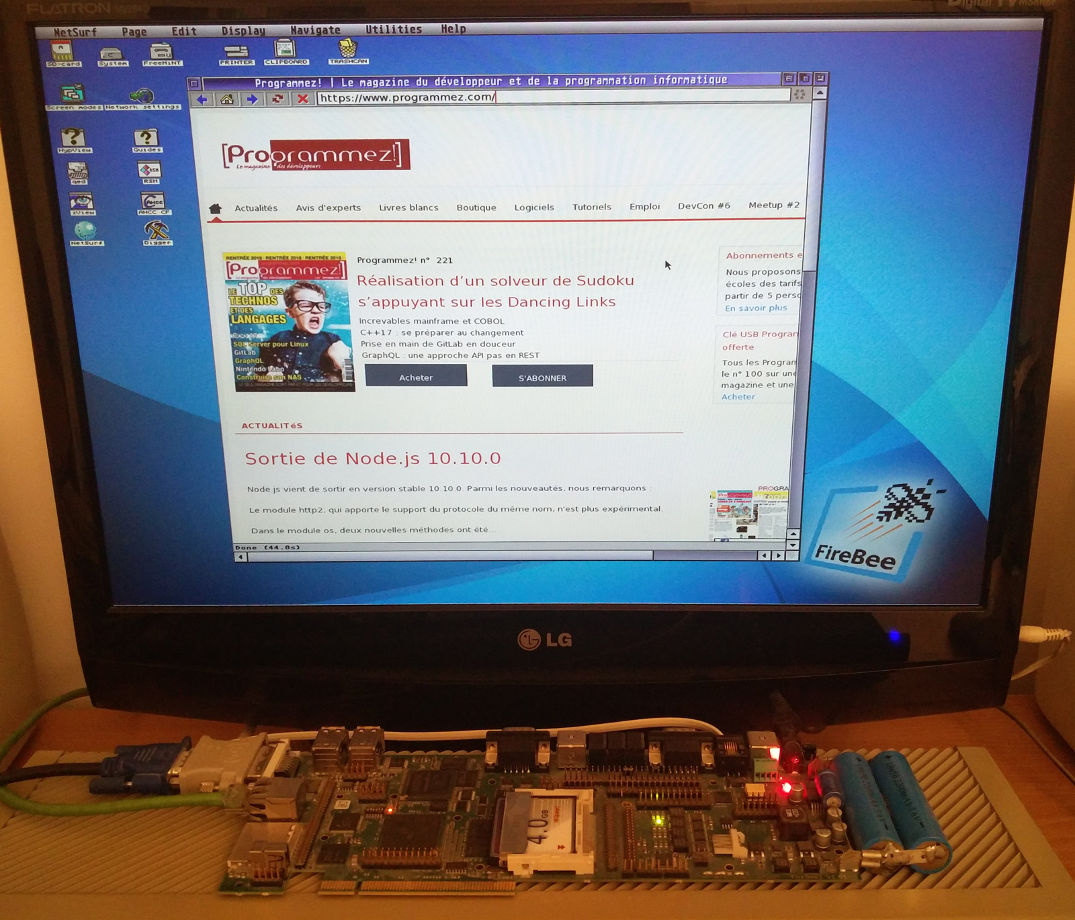
FireBee computer (2011) by the Atari Coldfire Project
FireTOS, FreeMiNT, XaAES, Tera Desktop
NetSurf web browser

Slide 45
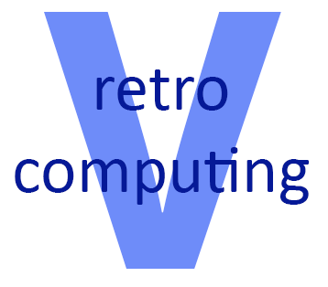
Want more?
foss-north 2018 presentation: Atari ST Free Operating Systems
YouTube channel: Vretrocomputing

Slide 46
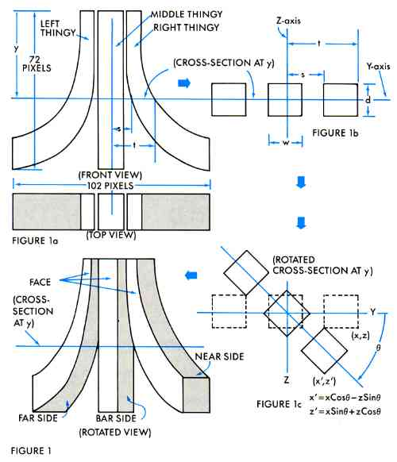
Questions?

